Slide 1
Sepsis and Management of Septic Shock
Professor Quazi Tarikul Islam
Professor of Medicine
Popular Medical College

Slide 2
CASE
24 yr old University student brought to ER with a H/O
fever for 3 days , cough, . Now presented with severe respiratory distress, RR-44/min, pulse 120/min,
BP 80/?, Partially cyanosed, cold sweaty skin.
Taken to ICU , Oxygen saturation 55% .
Immediate management started
Bronchopneumonia/ARDS/H1N1 pneumonia

Slide 3
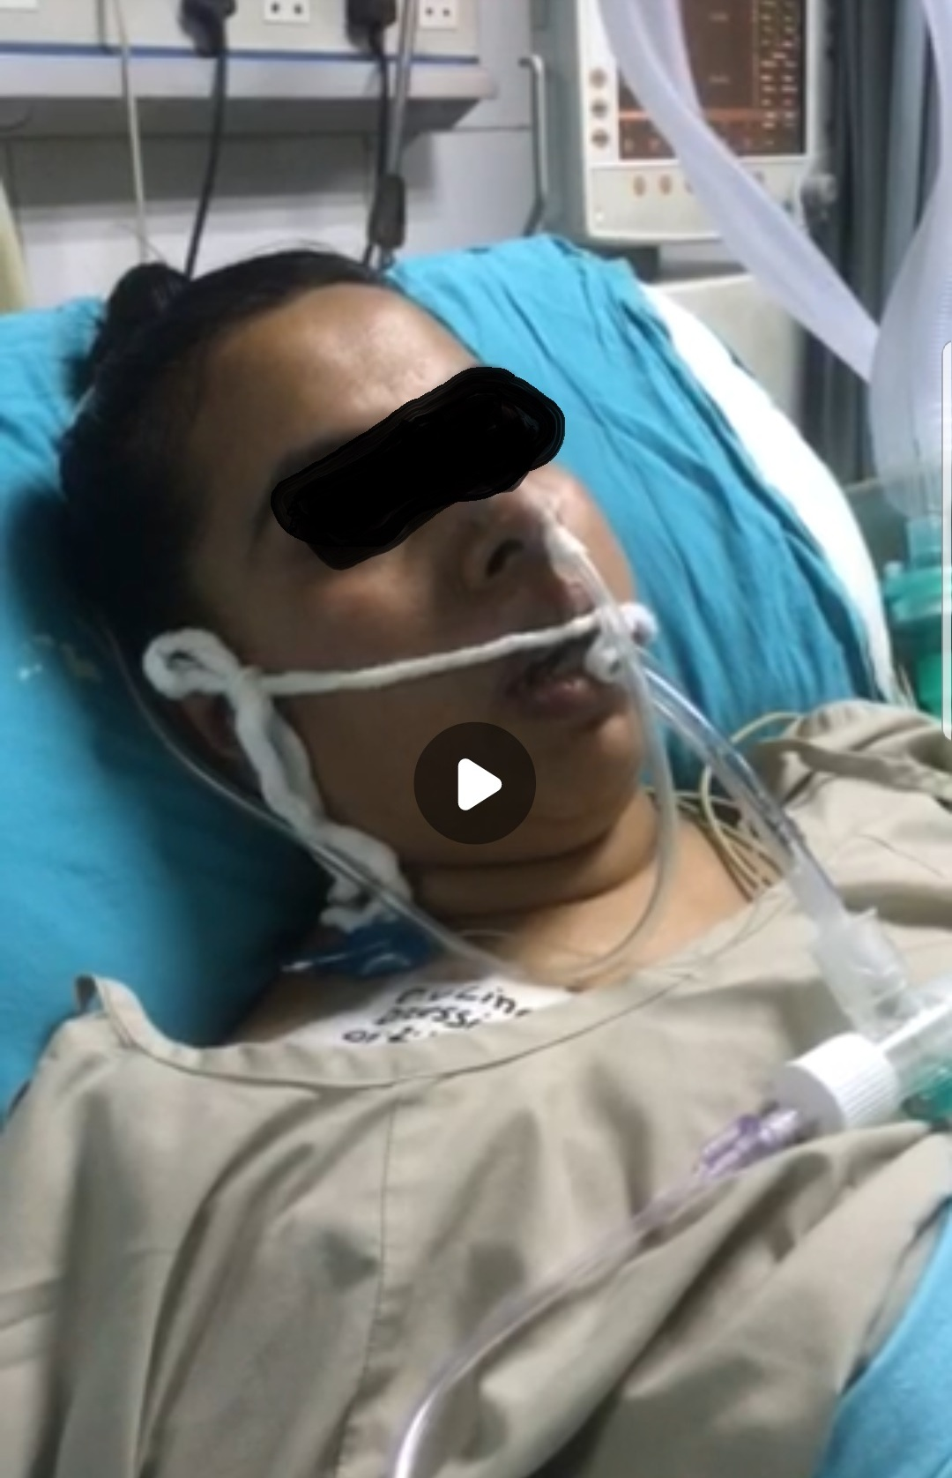
CASE
48 pages with NO magic bullets
Very few specific therapies directed at the early stages of sepsis pathophysiology
Numerous important recommendations (and numerous controversial ones)
Requires repetitive, complex assessments
Many interventions are time-sensitive

Slide 4
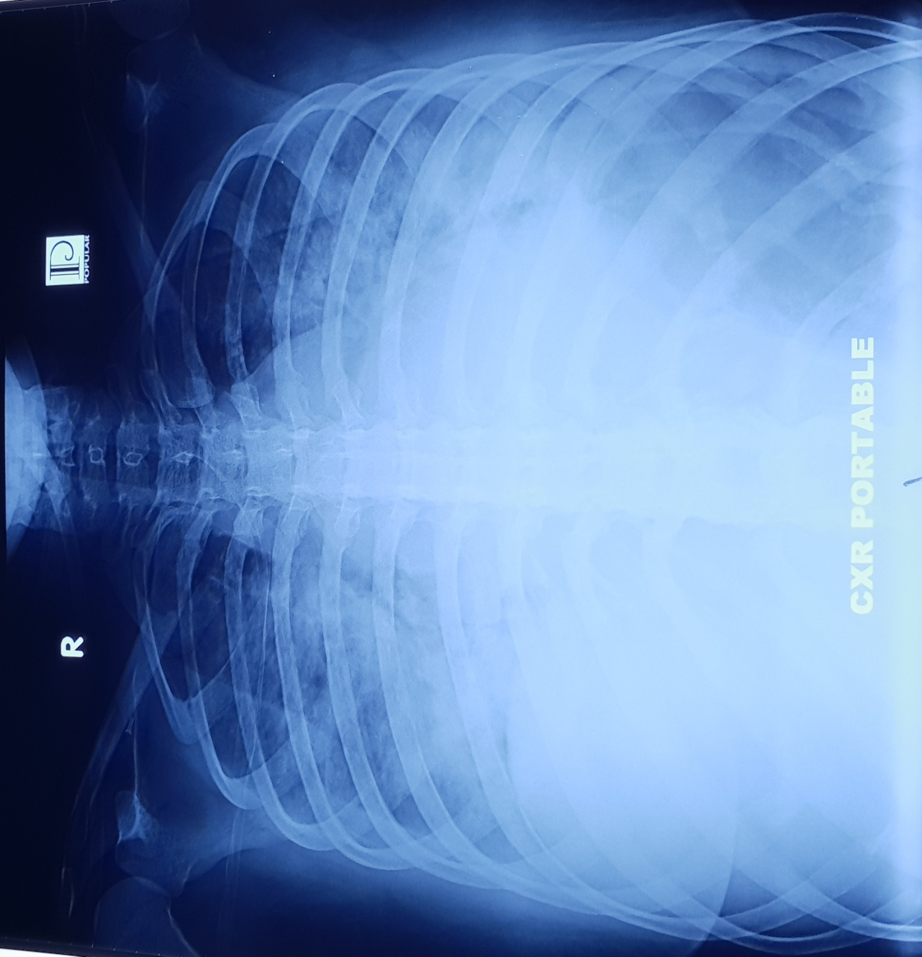

Slide 5
CASE
64yr male, Diabetic
24 hr Fever, productive cough, SOB and delirium
Initial Obs
  HR 162, RR 40, sats 90% on 15l, BP 85/50 (60), T 103
History
  24 hr Fever, productive cough, SOB and delirium. Last few hours with altered mental status and progressively less responsive to wife and inability to complete sentences 2/2 SOB. Wife called 911
Notes:
KEY POINTS
what is important in this patient to recognize ? (Vitals / Hx)
Things to look for on physical examination
What to order for labs/ diagnostic tests
Do you want to start therapy ? IF so, what ?
Does this patient need to be admitted ? If so, to where ?

Slide 6
KEY POINTS
what is important in this patient to recognize ? (Vitals / Hx)
Things to look for on physical examination
What to order for labs/ diagnostic tests
Do you want to start therapy ? IF so, what ?
Does this patient need to be admitted ? If so, to where ?

Slide 7
Sepsis and Management of Septic Shock
Introduction
Definition
Pathology
Clinical Features
Classification
Investigations
Management
Prevention

Slide 9
Purpose for Existence?
Today
Future
1,800,000
600,000
Severe Sepsis Cases
1,600,000
US Population
500,000
>750,000
cases of severe sepsis/year
in the US*
1,400,000
1,200,000
400,000
1,000,000
Total US Population/1,000
Sepsis Cases
300,000
800,000
600,000
200,000
Incidence projected to increase by 1.5% per year
400,000
100,000
200,000
2001
2025
2050
Year
Angus DC. Crit Care Med. 2001;29(7):1303-1310.
Notes:
Based on data from the US census, Angus et al estimate that the number of cases of severe sepsis will increase steadily at 1.5% per year, from a documented rate of 750,000 cases in 1995 to projections of 934,000 and 1,110,000 cases/year in 2010 and 2020. This increase in the incidence of severe sepsis is greater than the anticipated population growth. The expected rise is due to the high incidence of severe sepsis in older patients, a disproportionate increase in the number of elderly Americans, an increased number of people living with chronic or terminal disease such as diabetes or HIV, therapies for disease states which suppress the native immune system such as chemotherapy for cancer or immunosuppressive agents after organ transplant.

Slide 10
Comparison With
Other Major Diseases
Incidence of Severe Sepsis
Mortality of Severe Sepsis
Cases/100,000
AIDS*
Colon
Breast
CHF†
Severe Sepsis‡
AIDS*
Breast Cancer§
AMI†
Severe
Sepsis‡
Cancer§
†National Center for Health Statistics, 2001. §American Cancer Society, 2001. *American Heart Association. 2000. ‡Angus DC et al. Crit Care Med. 2001;29(7):1303-1310.
Notes:
In a study based on 1995 hospital discharge data, the incidence of severe sepsis was documented as 300 per 100,000 population. This is significantly greater than the incidence of other well recognized diseases such as CHF; and Colon cancer, breast cancer, and AIDS combined. The annual mortality of severe sepsis in 1995 was 215,000 – which is comparable to the prehospital death rate of acute myocardial infarction, and significantly greater than death rates from breast cancer and AIDS.

Slide 11
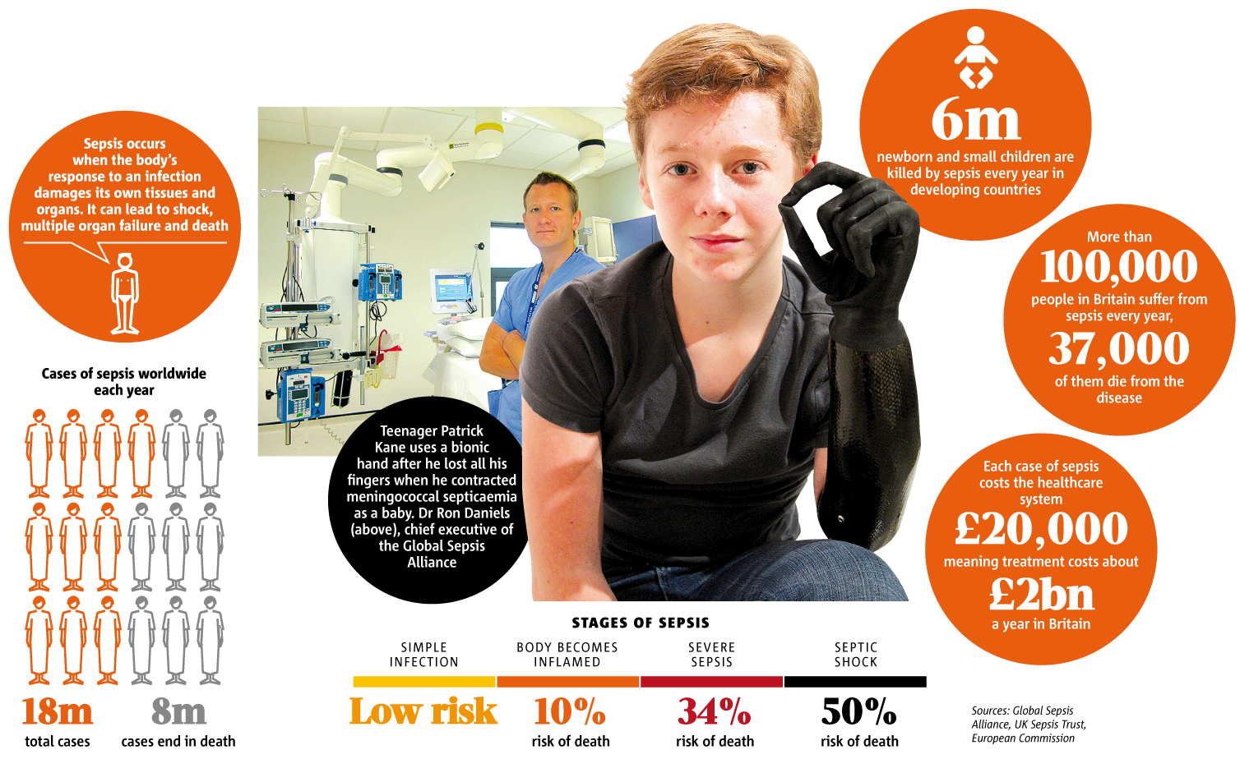
Global Sepsis

Slide 12

Why the burden of sepsis increasing?
Increased geriatric population
Increased number of immunocompromised host
Increasing drug resistant organism
Increasing metabolic disorder

Slide 13
Consensus definitions…
1991 - American College of Chest Physicians and the Society of Critical Care Medicine Consensus Conference.
2001 - Society of Critical Care Medicine, the European Society of Intensive Care Medicine, The American College of Chest Physicians, the American Thoracic Society and the Surgical Infection Society.
2016 - Society of Critical Care Medicine and the European Society of Intensive Care Medicine Redefinitions Task Force.

Slide 14


ACCP/SCCM Consensus Conference
1991 (Sepsis-1)
Sepsis = Infection + two or more SIRS criteria
Severe Sepsis = Sepsis + Organ dysfunction or hypo-perfusion
Septic Shock = Severe sepsis with persistent hypotension despite adequate fluids

Slide 16
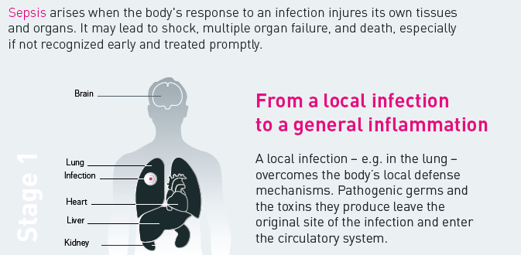
What is Sepsis?
Stage 1
Source: world-sepsis-day.org

Slide 17
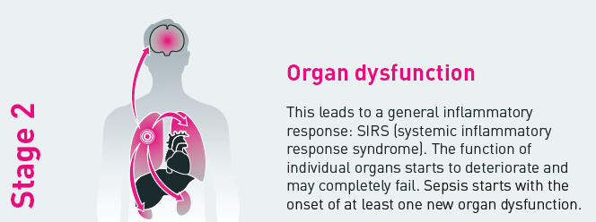
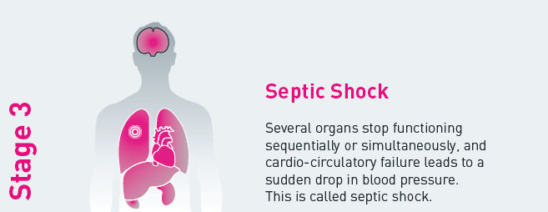
What is Sepsis?
Source: world-sepsis-day.org

Slide 18
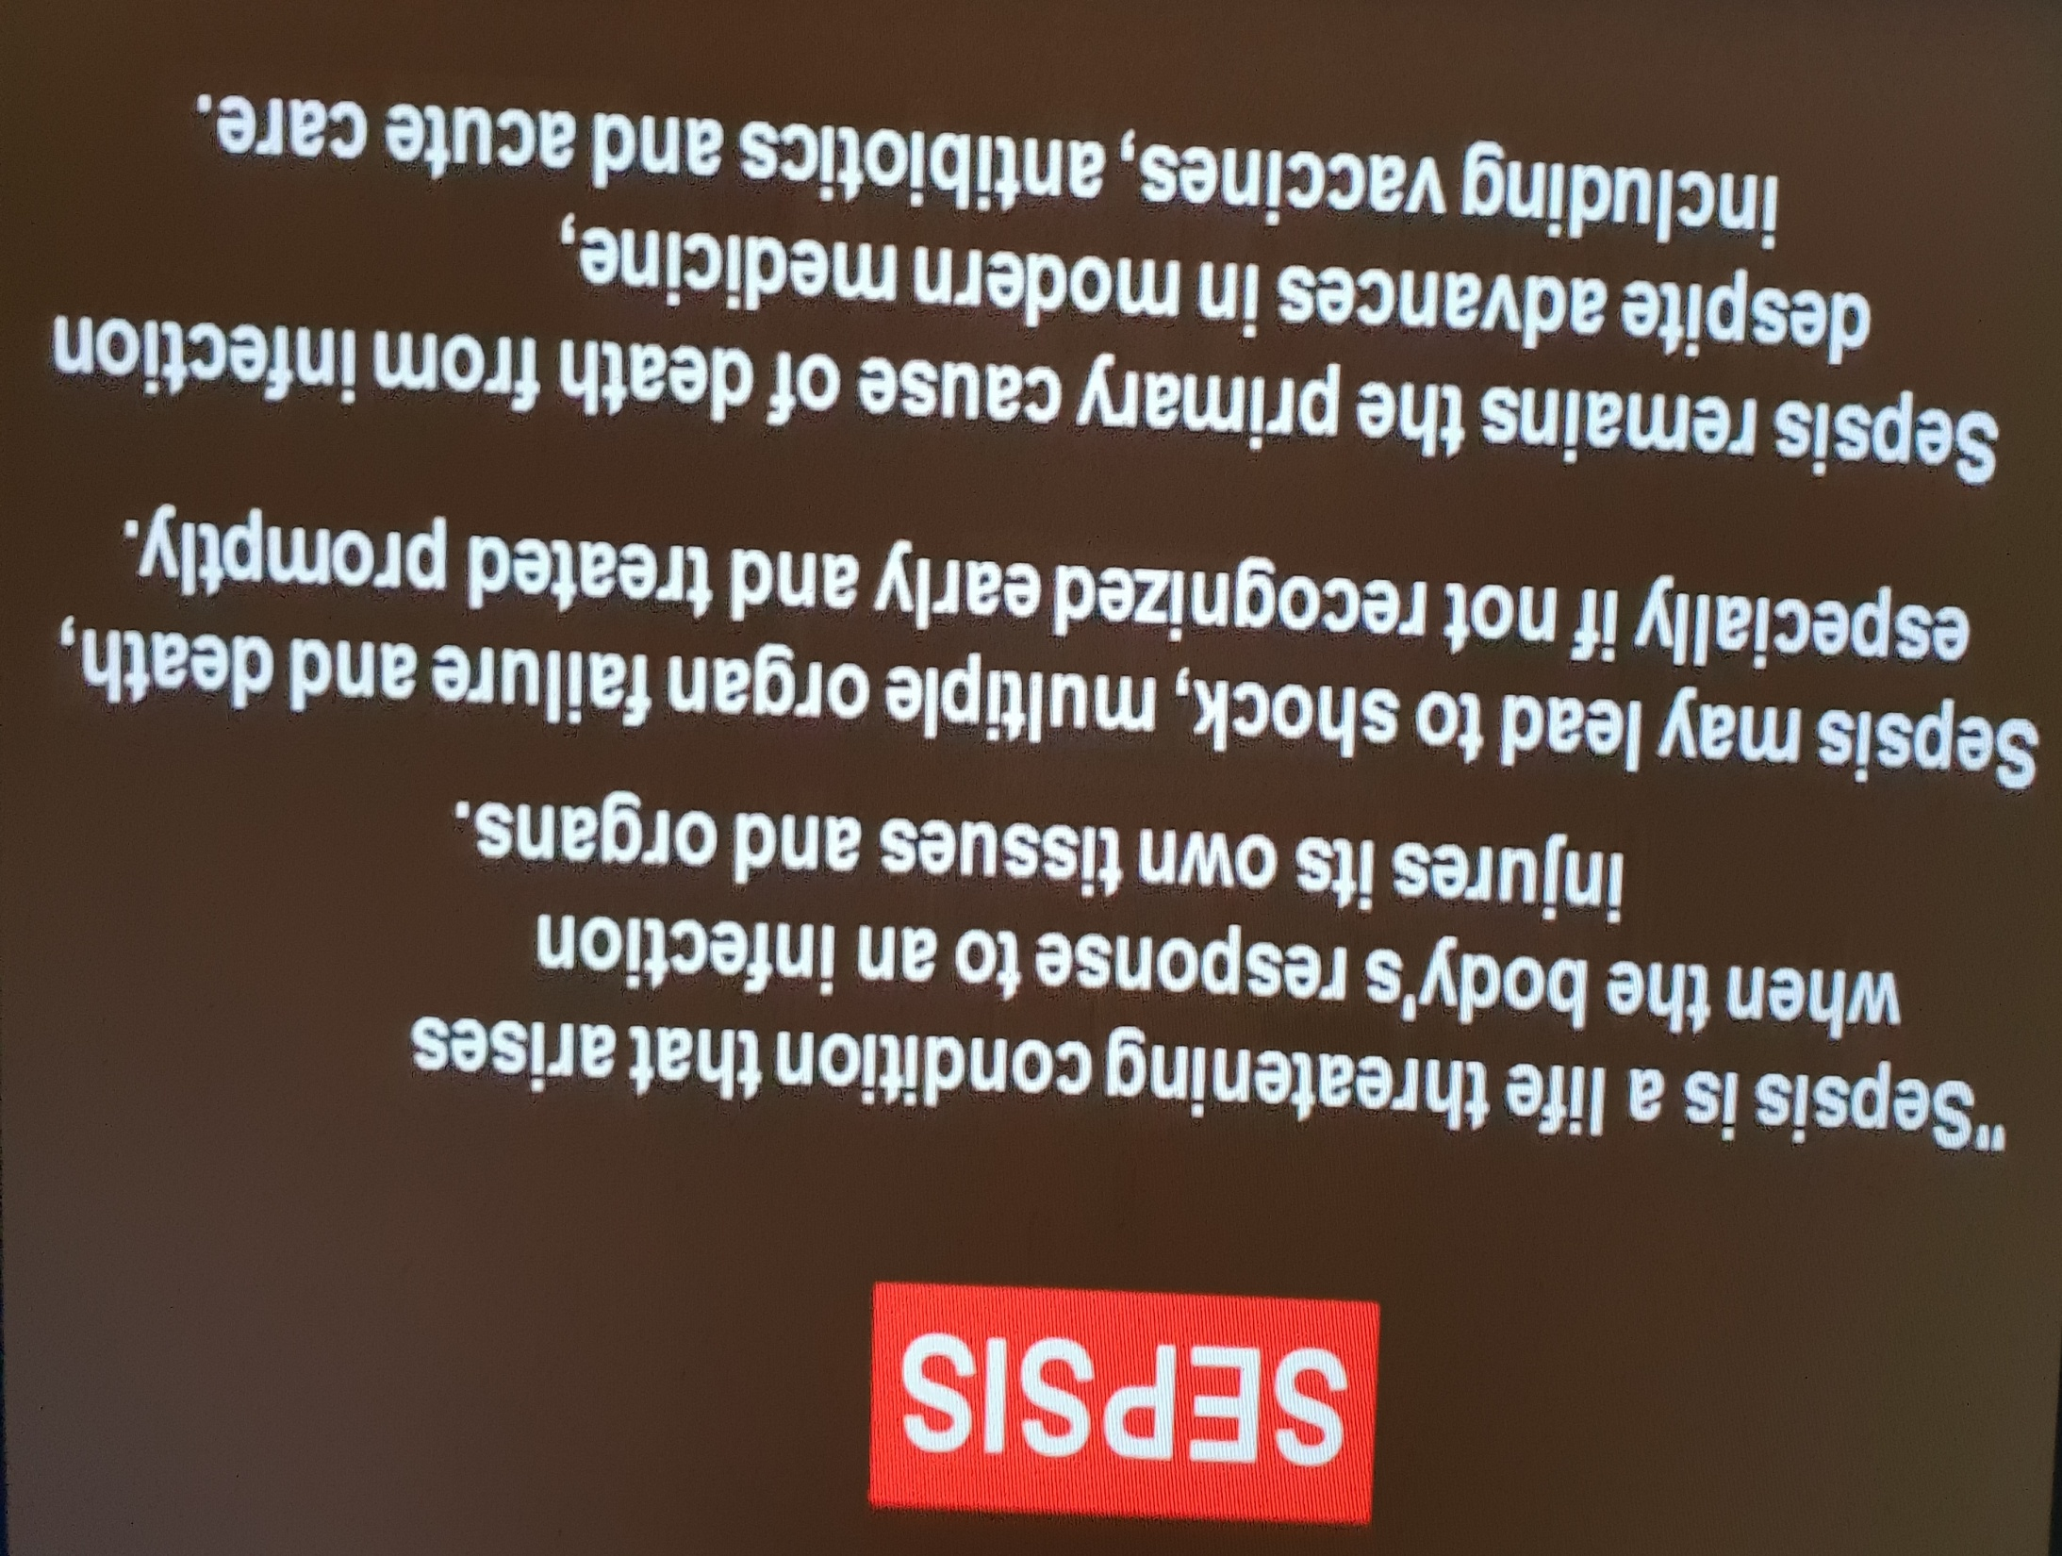

Slide 19
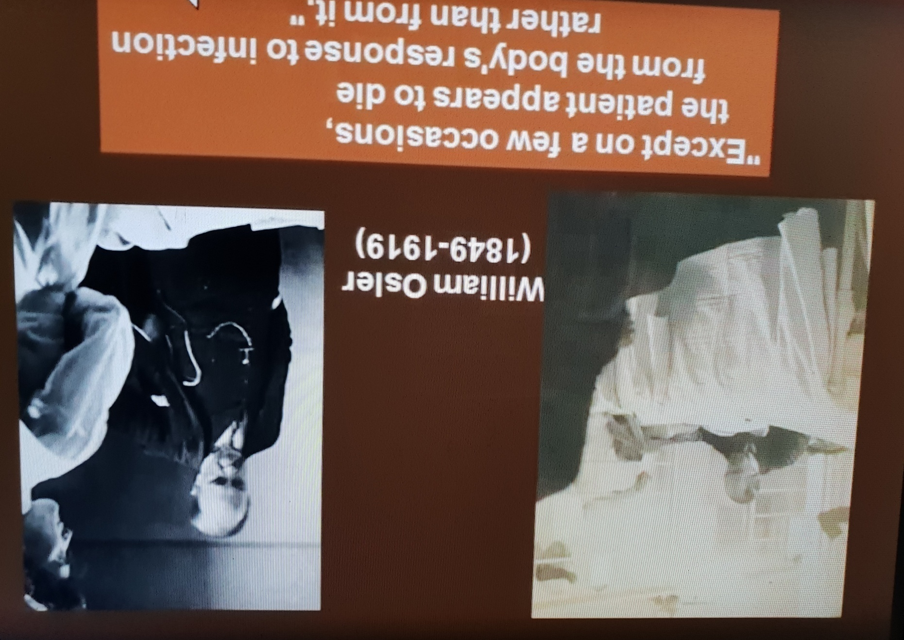

Slide 20
New sepsis definition
  Persistent hypotension requiring vasopressors to keep MAP > 65 mmHg despite adequate fluid resuscitation
  Serum lactate > 2 mmol/L
JAMA 2016

Slide 21
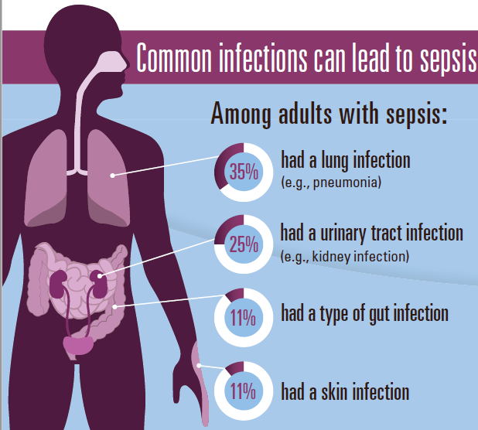

Slide 22
Epidemiology….
Annual rate of more than 1,665,000 cases of sepsis in USA between 1979 and 2000 (Elixhauser et al, 2013).
Retrospective analysis of an international database reported a global incidence of 437 per 100,000 person-years for sepsis between the years 1995 and 2015 (Fleischman et al,2016)

Slide 23
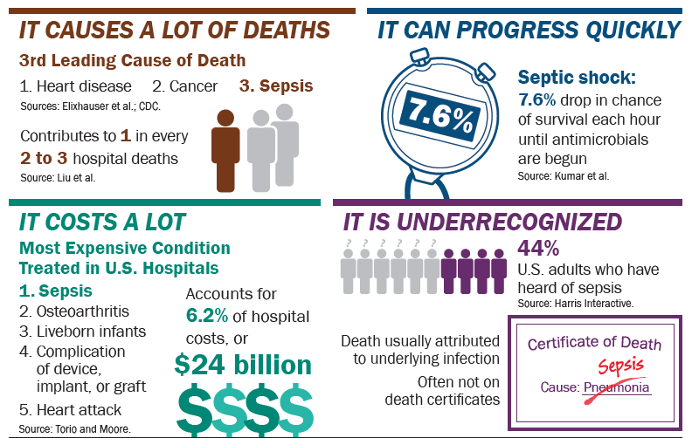
Sepsis at a Glance

Slide 24

Sepsis is a medical emergency
minutes matter
Every hour a patient in septic shock doesn't receive antibiotics,
the risk of death increases by 7.6%.
Source: Advisory Board Company: “Why sepsis screening isn't one-size-fits-all” Expert Insight | December 11, 2013

Slide 25

Speed is Important
Time is Tissue!
Would you wait an hour to treat a stroke? Heart attack?
Mortality rates increase as the number of failing organs increase.

Slide 26
To understand and be able to identify the differences between SIRS, Sepsis, Severe Sepsis, and Septic Shock.
To understand the morbidity and mortality of Sepsis in relation to length of stay, current guidelines, cost to health care systems.
To understand modalities of treatment which include management, such as fluid resuscitation and pharmacological interventions.

Slide 27
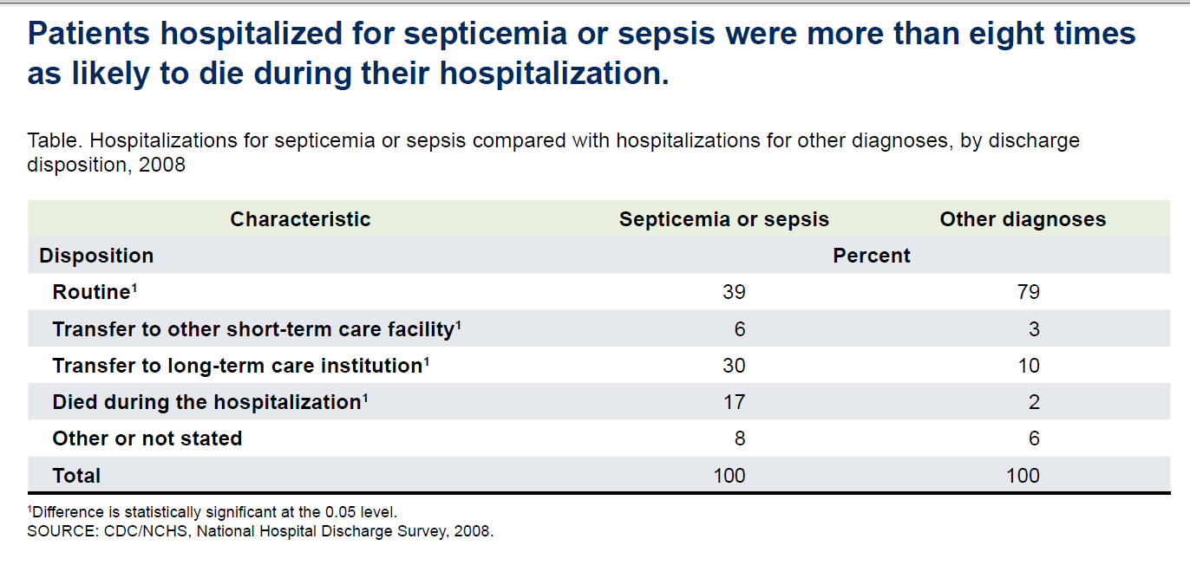
In-hospital death 8X higher compared to other diagnoses

Slide 28
Economic Burden
Sepsis is a major and economically significant disease in the ICU, costing over $20 billion in the United States in 2011 (5.2% of all U.S. hospital costs) with costs growing to over $23 billion in 2013 (6.2% of all U.S. hospital costs)

Slide 29

Sepsis ECONOMICS
Sepsis: major health problem with increasing prevalence, high costs, and poor outcomes.

Slide 30
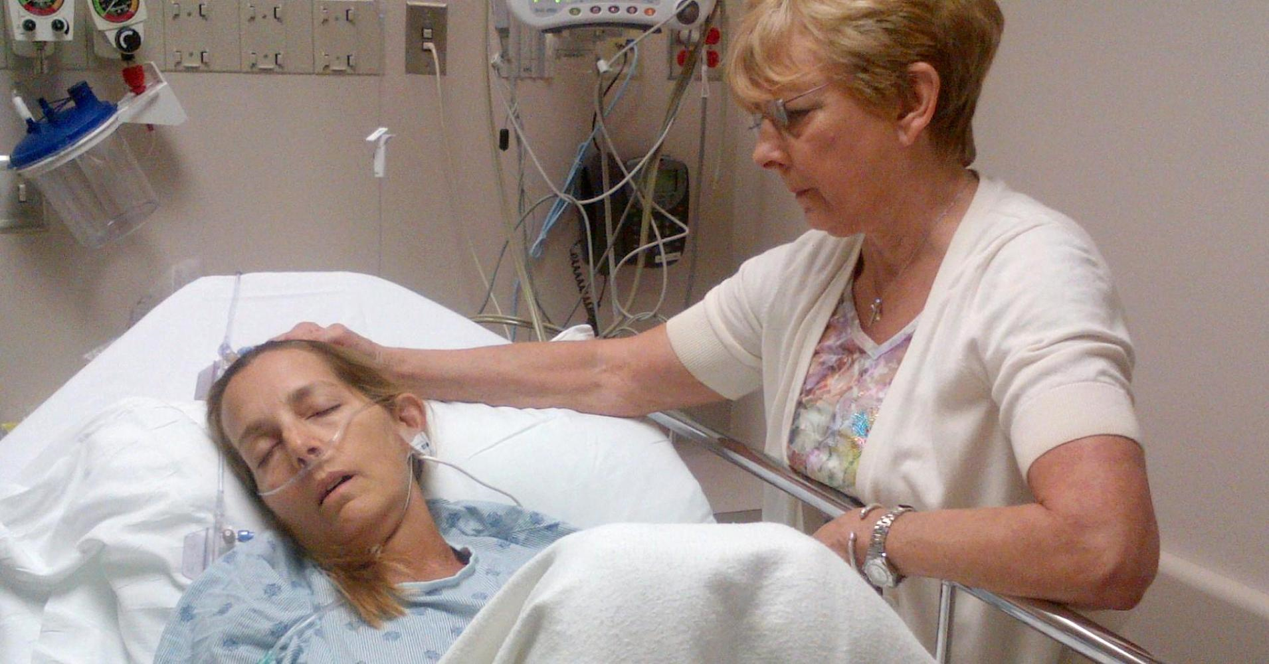
Sepsis ECONOMICS
Increased hospitalizations for more than 1 million people in 2008

Slide 31
Where would the patient be best managed ?
ICU
Intensive Care Unit

Slide 32
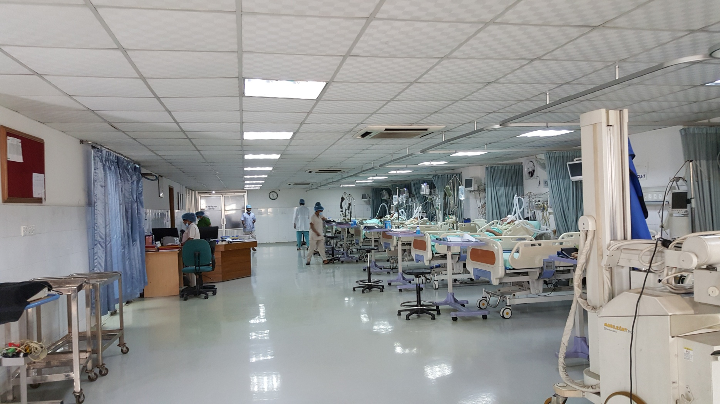
ICU

Slide 33
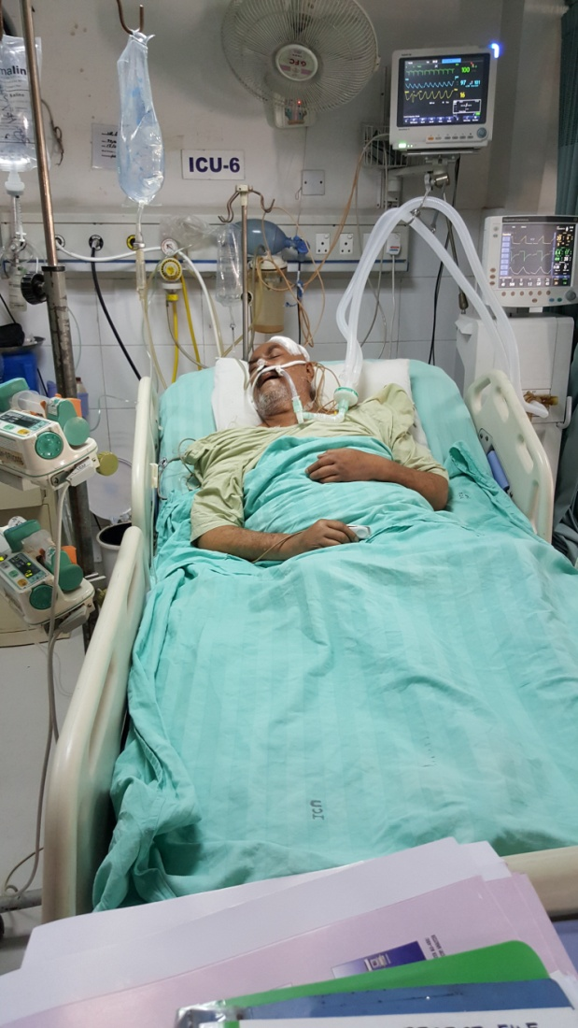
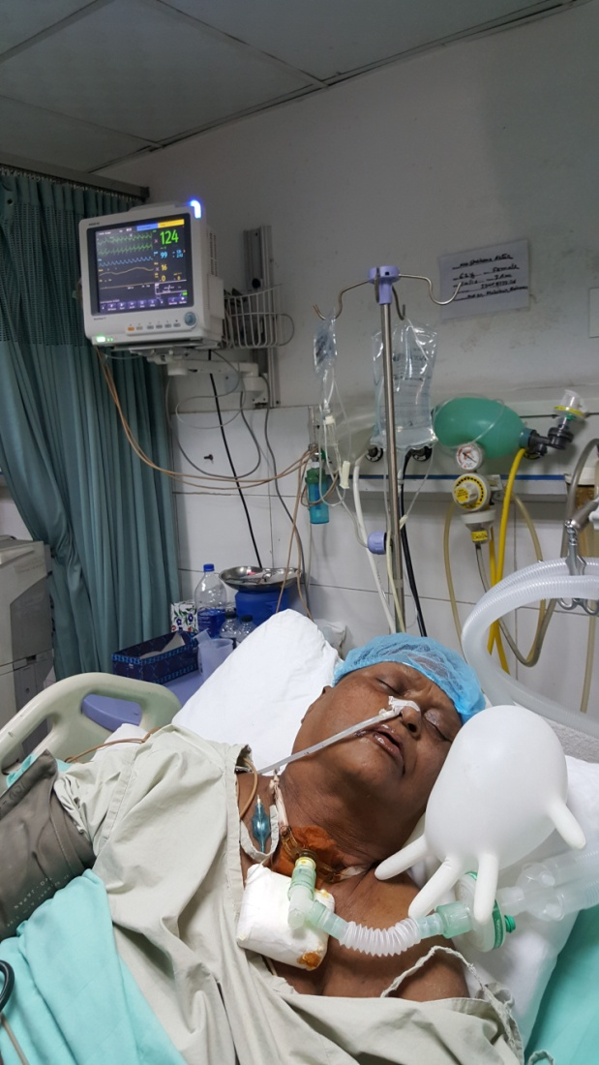
They are this kind of unfortunate patients

Slide 35
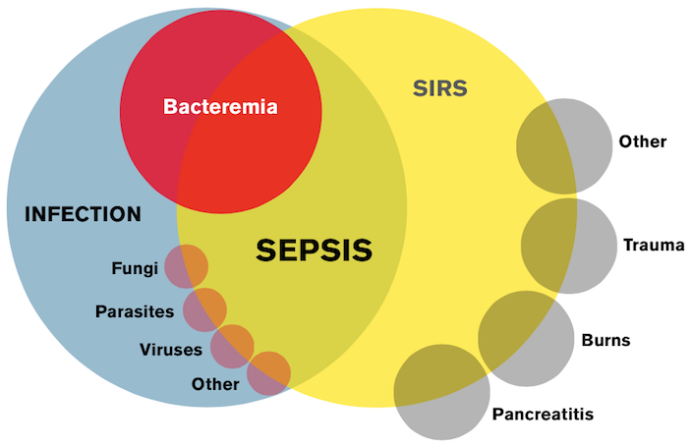
Infection, SIRS, Sepsis

Slide 36
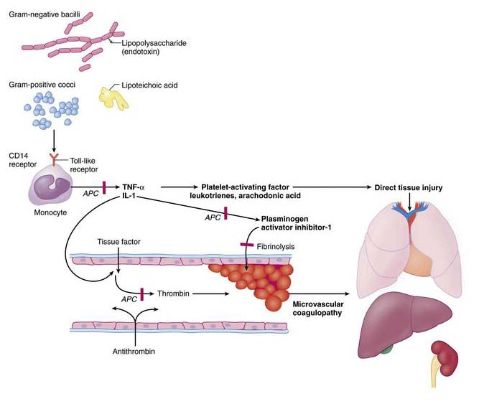
Pathophysiology of Sepsis…

Slide 37
Sepsis Pathogenesis
Unbalanced Immune Reaction
Mediators of
Inflammation
Tissue Factor
Procoagulant State
ROS
Microvascular
Thrombosis
Vasodilation
Capillary
Leak
Notes:
An incompletely understood pathogenesis: hallmarks are microvascular thrombosis, vasodilation, free radical damage, Capillary Leak

Slide 38
Pathophysiology of sepsis- induced ischaemic
Organ injury
Cytokine production leads to massive production of endogenous vasodilators
Structural changes in the endothelium result in extravasation of intravascular fluid into interstitium and subsequent tissue oedema
Plugging of select microvascular beds with neutrophils, fibrin aggregates and microthrombi impair microvascular perfusion
Organ specific vasoconstriction.

Slide 39
Pathophysiology of sepsis- induced Organ injury….
Multiple organ dysfunction ( MODS) and multiple organ failure (MOF) from diffuse cell injury/ death resulting in compromised organ function.
Mechanism of cell injury & Death:
Cellular necrosis
Apoptosis
Leukocyte- mediated tissue injury
Cytopathic Hypoxia

Slide 40
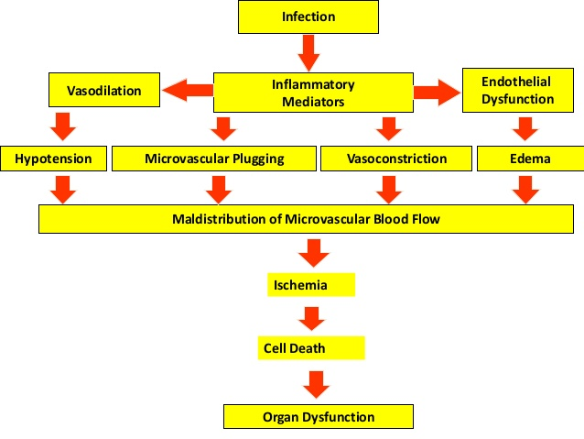

Slide 41
Pathophysiology of vasodilation in sepsis
Loss of sympathetic responsiveness
Down regulation of adrenergic receptor number and sensitivity, possible altered signal transduction
Vasodilatory inflammatory mediator
Endotoxin has direct vasodilatory effects
Increased Nitric oxide production

Slide 42
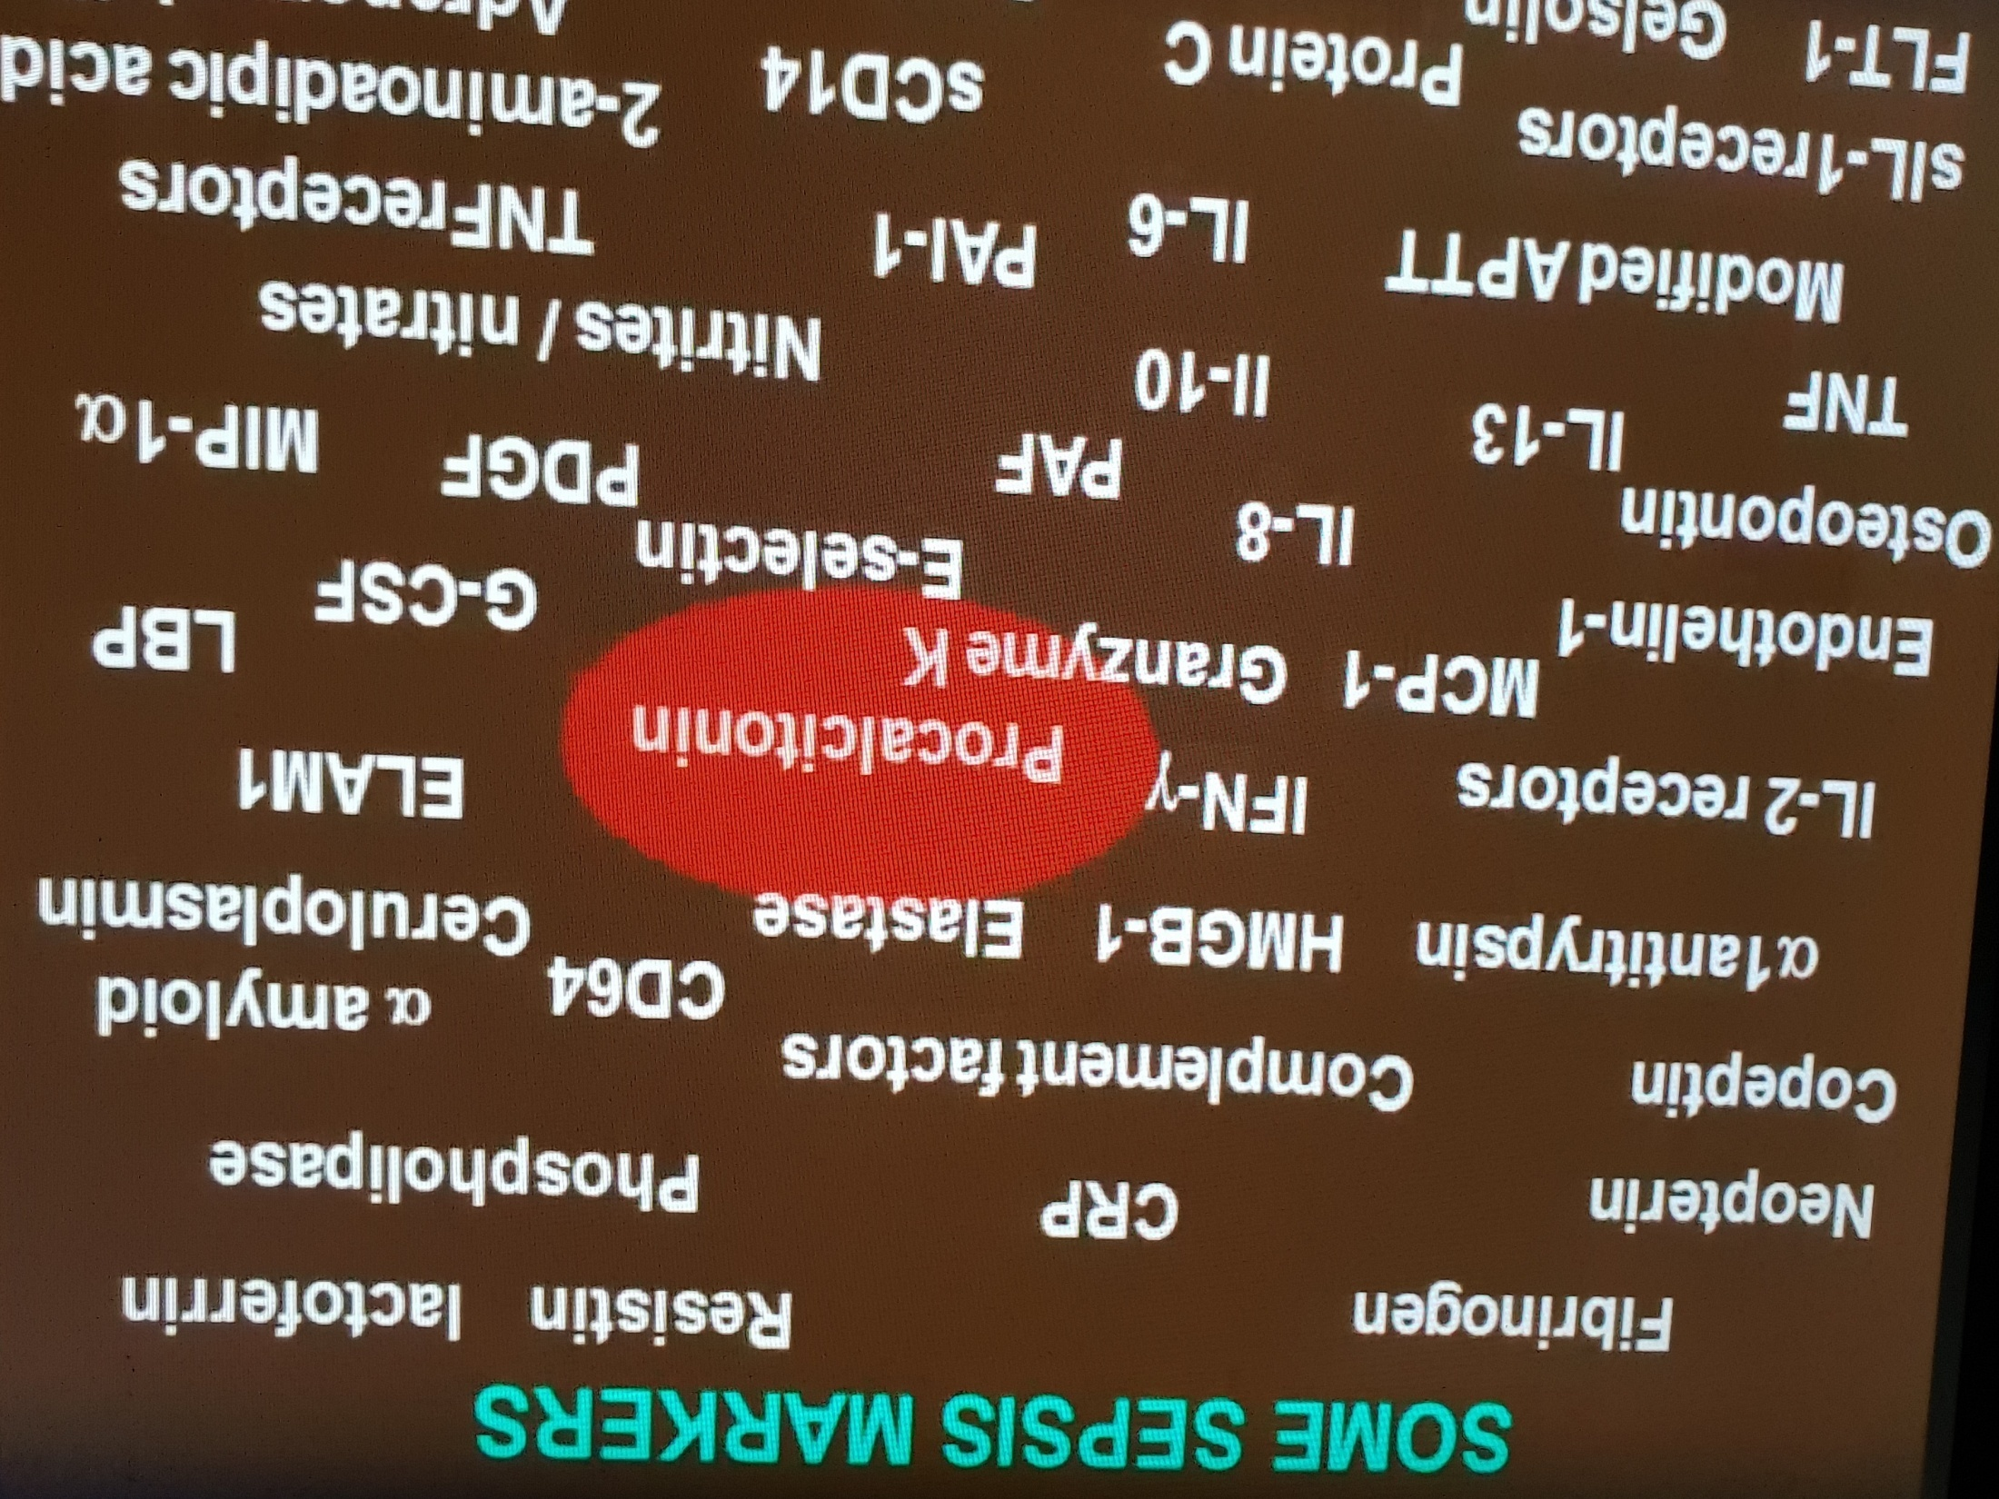

Slide 43
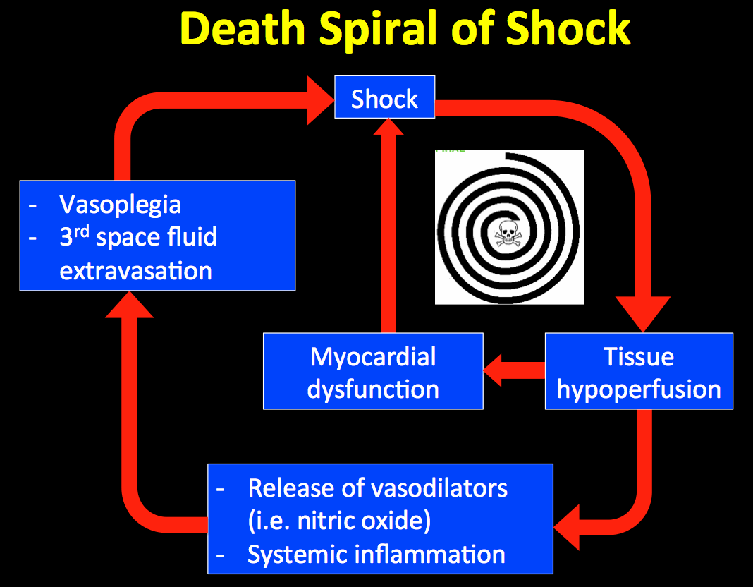

Slide 44
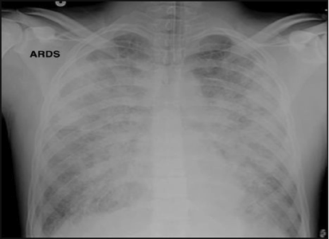
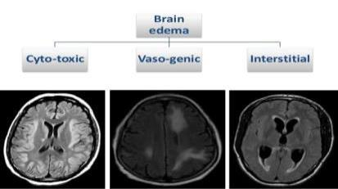
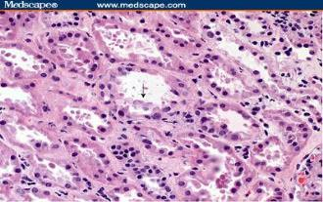
HEMODYNAMIC CHANGES IN SEPTIC SHOCK
Interstitial Edema in Septic Shock
Lungs
Brain
Kidney

Slide 46
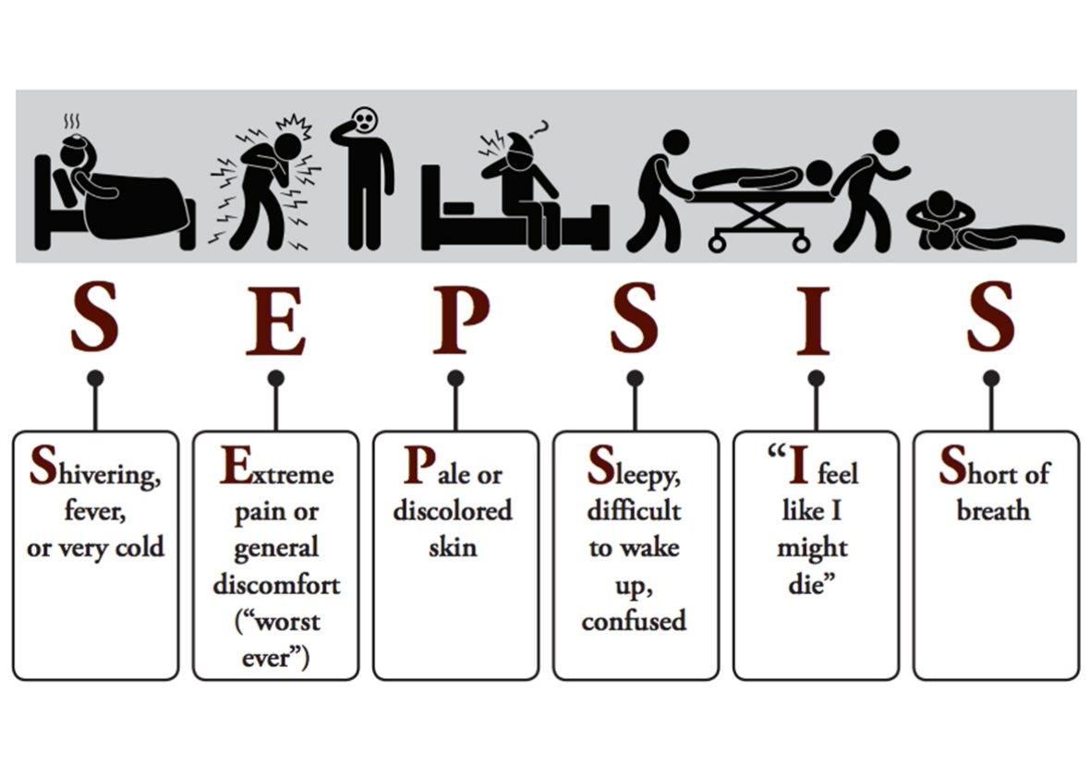
When suspect Sepsis .....?

Slide 47
SIRS
SIRS – systemic inflammatory response syndrome
Must have at least 2 of the following:
  Temperature >38.5ºC or <36ºC
  Heart rate >90 beats/min
  Respiratory rate >20 breaths/min or PaCO2 <32 mmHg
  WBC >12,000 cells/mm3, <4000 cells/mm3, or >10 % immature (band) forms
SIRS is the body’s response to infection, inflammation, stress.
Definitions according to the American College of Chest Physicians (ACCP) and Society of Critical Care Medicine (SCCM) in 1992
Notes:
Definitions according to the American College of Chest Physicians (ACCP) and Society of Critical Care Medicine (SCCM) in 1992

Slide 48
Identification of Sepsis…
Suggested Clinical Criteria for
Sepsis (if in ICU?)
Infection + 2 or more SOFA points (above baseline)
Consider Sepsis outside ICU if
Infection + 2 or more qSOFA points

Slide 49
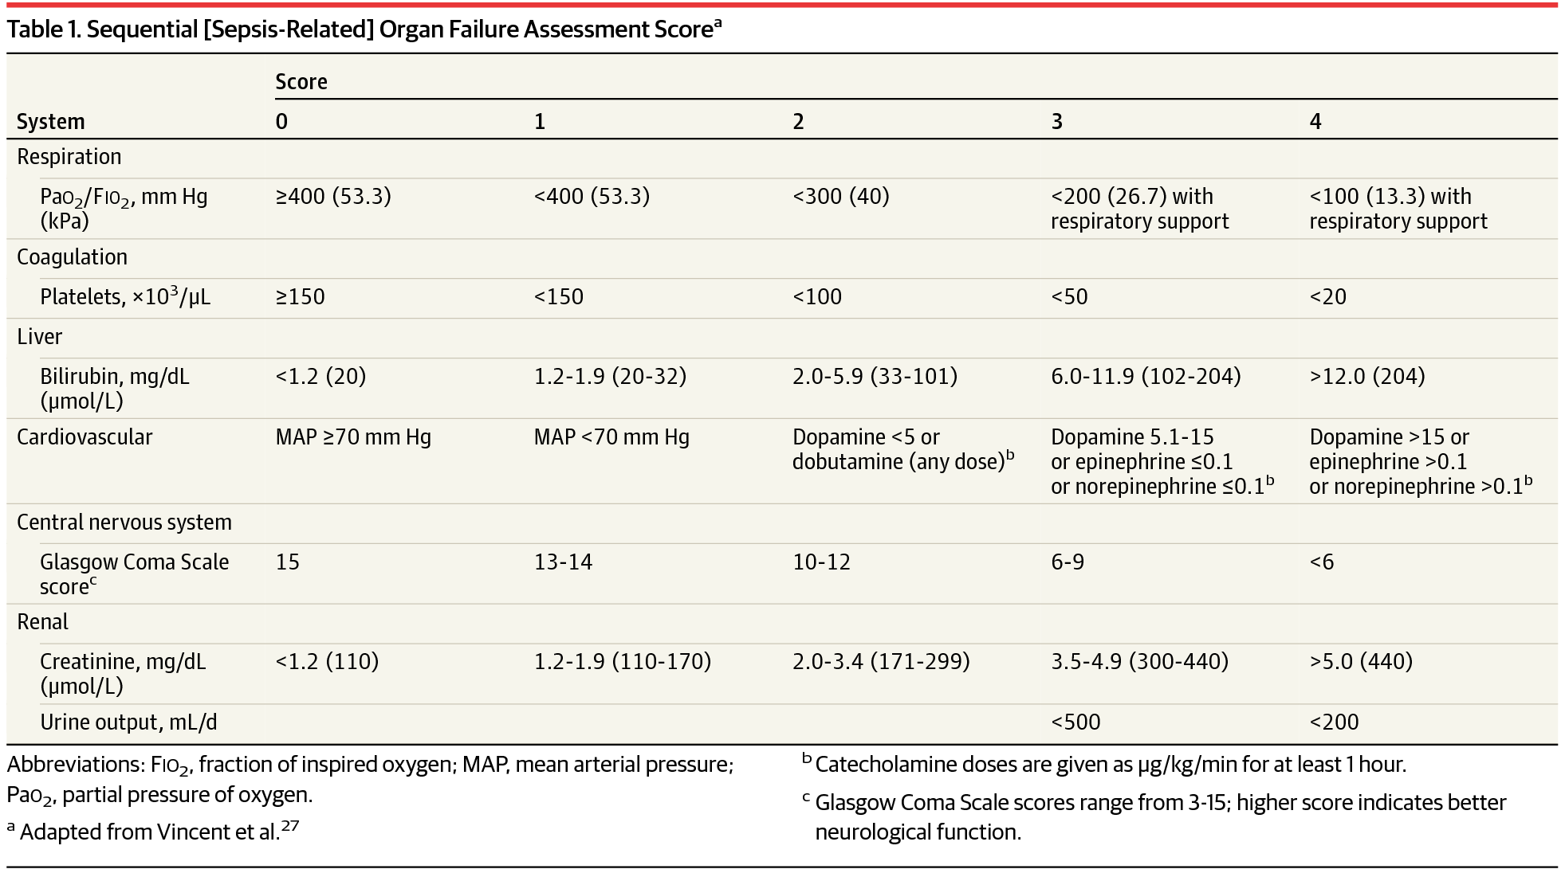

Slide 50
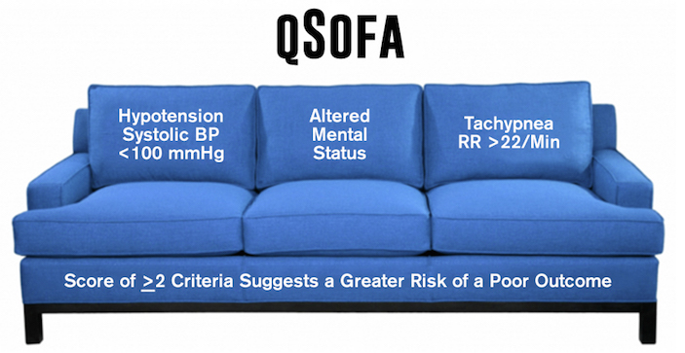
Q- SOFA…

Slide 51

Quick SOFA / qSOFA
SEPSIS Scoring tool
> 22/ min
SBP ≤100mmHg
In patients with infection a qSOFA score > 2 is associated with higher mortality and prolonged ICU stay.

Slide 52
Limitations of SOFA….
Cumbersome due to multiple variables
Not well known outside ICU setting
Variables are cutoff values were developed by Consensus.

Slide 53
Sepsis and Severe Sepsis
Sepsis – SIRS + suspected or confirmed infection (documented via cultures or visualized via physical exam/imaging)
Severe Sepsis – Sepsis + at least one sign of organ hypo-perfusion or dysfunction
Areas of mottled skin | Disseminated intravascular coagulation
Capillary refill > 3 secs | AKI
UOP < 0.5cc/kg /hr | ARDS or acute lung injury (ALI)
Lactate > 2mmol /L | Cardiac dysfunction on echo
Altered mental status | Plt < 100
Abnormal EEG | Troponin Leak

Slide 54
Septic Shock
Septic Shock - Severe sepsis plus one of the following conditions:
  MAP <60 mm Hg (<80 mm Hg if previous hypertension) after adequate fluid resuscitation
  Need for pressors to maintain BP after fluid resuscitation
  Adequate fluid resuscitation = 40 to 60 mL/kg saline solution (NS 5L-10L)
  Lactate > 4mmol /L
Notes:
HIGHEST RISK OF MORTALITY

Slide 55
Diagnostic Criteria for Sepsis
Infection, documented or suspected, and some of the following:
General variables
Fever (> 38.3°C)
Hypothermia (core temperature < 36°C)
Heart rate > 90/min–1 or more than two sd above the normal value for age
Tachypnea
Altered mental status
Significant edema or positive fluid balance (> 20 mL/kg over 24 hr)
Hyperglycemia (plasma glucose > 140 mg/dL or 7.7 mmol/L) in the absence of diabetes

Slide 56
Inflammatory variables:
Leukocytosis (WBC count > 12,000 μL–1)
Leukopenia (WBC count < 4000 μL–1)
Normal WBC count with greater than 10% immature forms
Plasma C-reactive protein more than two SD above the normal value
Plasma procalcitonin more than two SD above the normal value
Hemodynamic variables:
Arterial hypotension (SBP < 90 mm Hg, MAP < 70 mm Hg, or an SBP decrease > 40 mm Hg in adults or less than two SD below normal for age)

Slide 57
Organ dysfunction variables:
Arterial hypoxemia (Pao2/Fio2 < 300)
Acute oliguria (urine output < 0.5 mL/kg/hr for at least 2 hrs despite adequate fluid resuscitation)
Creatinine increase > 0.5 mg/dL or 44.2 μmol/L
Coagulation abnormalities (INR > 1.5 or aPTT > 60 s)
Ileus (absent bowel sounds)
Thrombocytopenia (platelet count < 100,000 μL–1)
Hyperbilirubinemia (plasma total bilirubin > 4 mg/dL or 70 μmol/L)

Slide 58
Tissue perfusion variables:
Hyperlactatemia (> 1 mmol/L)
Decreased capillary refill or mottling
Severe Sepsis:
Sepsis plus organ dysfunction
Septic Shock:
Sepsis plus either hypotension( Refractory to intravenous fluids) or hyperlactatemia.

Slide 59
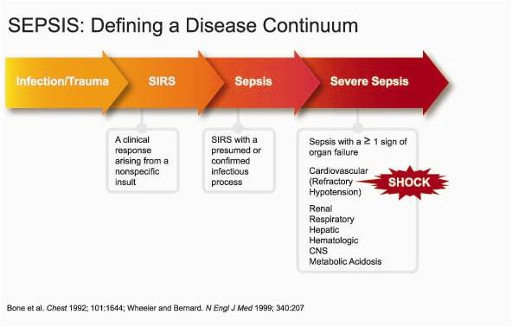
SEPSIS
A continuum of severity describing the host systemic inflammatory response
Notes:
Stress that this is a spectrum of syndromes from SIRS progressing to Septic Shock, importance of identifying which step in this spectrum a patient is in to predict outcomes as well as decide on therapies.

Slide 60
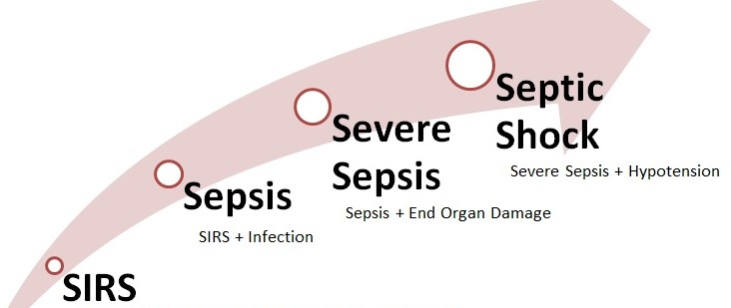

Slide 61
Terminology
Systemic Inflammatory Response Syndrome (SIRS)
  Temp > 38 or < 36
  HR > 90
  RR > 20 or PaCO2 < 32
  WBC > 12 or < 4 or Bands > 10%
Sepsis
  The systemic inflammatory response to infection.
Severe Sepsis
  Organ dysfunction secondary to Sepsis.
  e.g. hypoperfusion, hypotension, acute lung injury, encephalopathy, acute kidney injury, coagulopathy.
Septic Shock
  Hypotension secondary to Sepsis that is resistant to adequate fluid administration and associated with hypoperfusion.
TWO out of four criteria
acute change from baseline
Bone, R., Balk, R., Cerra, F., Dellinger, R., Fein, A., Knaus, W., Schein, R., et al. (1992). Definitions for sepsis and organ failure and guidelines for the use of innovative therapies in sepsis. The ACCP/SCCM Consensus Conference Committee. American College of Chest Physicians/Society of Critical Care Medicine. Chest, 101(6), 1644–1655.

Slide 62

JAMA.2016;315(8):801-810. doi:10.1001/jama.2016.0287
Task Force made up of 19 Intensivists convened to update Sepsis Definitions, understanding there’s no validated diagnostic test (Gold Standard)
“The current use of 2 or more SIRS criteria to identify sepsis was unanimously considered by the task force to be unhelpful.”

Slide 63
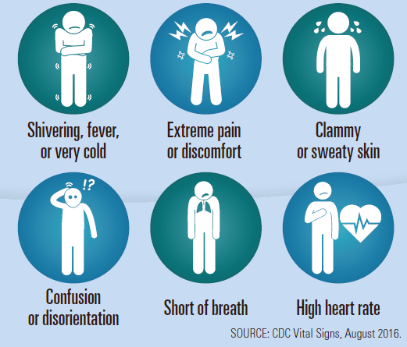
Know the Signs & Symptoms

Slide 64
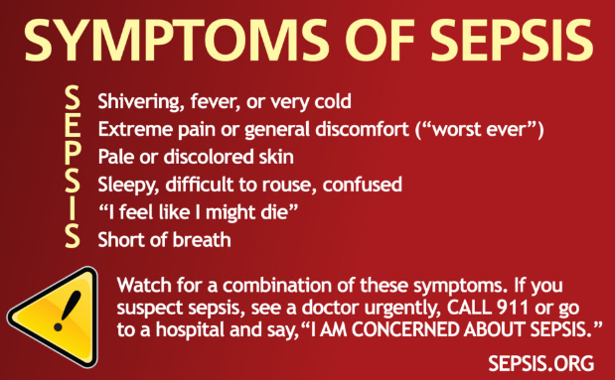
Know the Signs & Symptoms

Slide 65
New definition…
Sepsis (with organ dysfunction) – now defined as life-threatening organ dysfunction caused by a dysregulated host response to infection. This is a clinical diagnosis.
Note that “Severe sepsis” (previously used for sepsis with organ dysfunction) is no longer recognized since it would be redundant.

Slide 66
Septic Shock – a subset of Sepsis with circulatory and cellular/metabolic dysfunction associated with a higher risk of mortality. This is a clinical diagnosis.
Sepsis (with organ dysfunction) and Septic Shock are medical emergencies and it is recommended that treatment and resuscitation begin immediately.

Slide 67
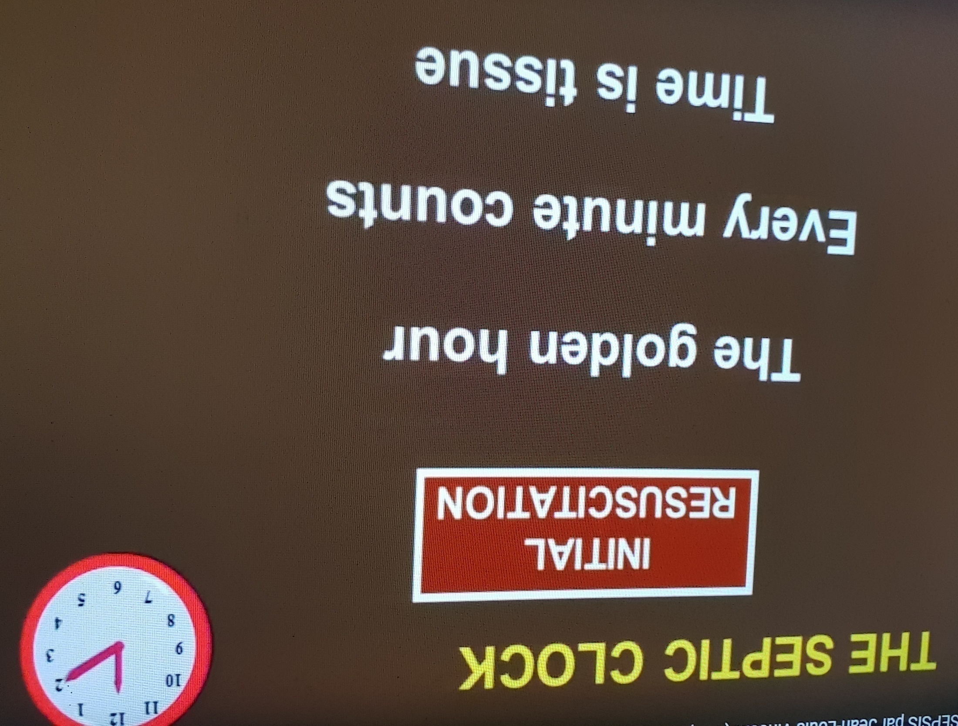

Slide 68
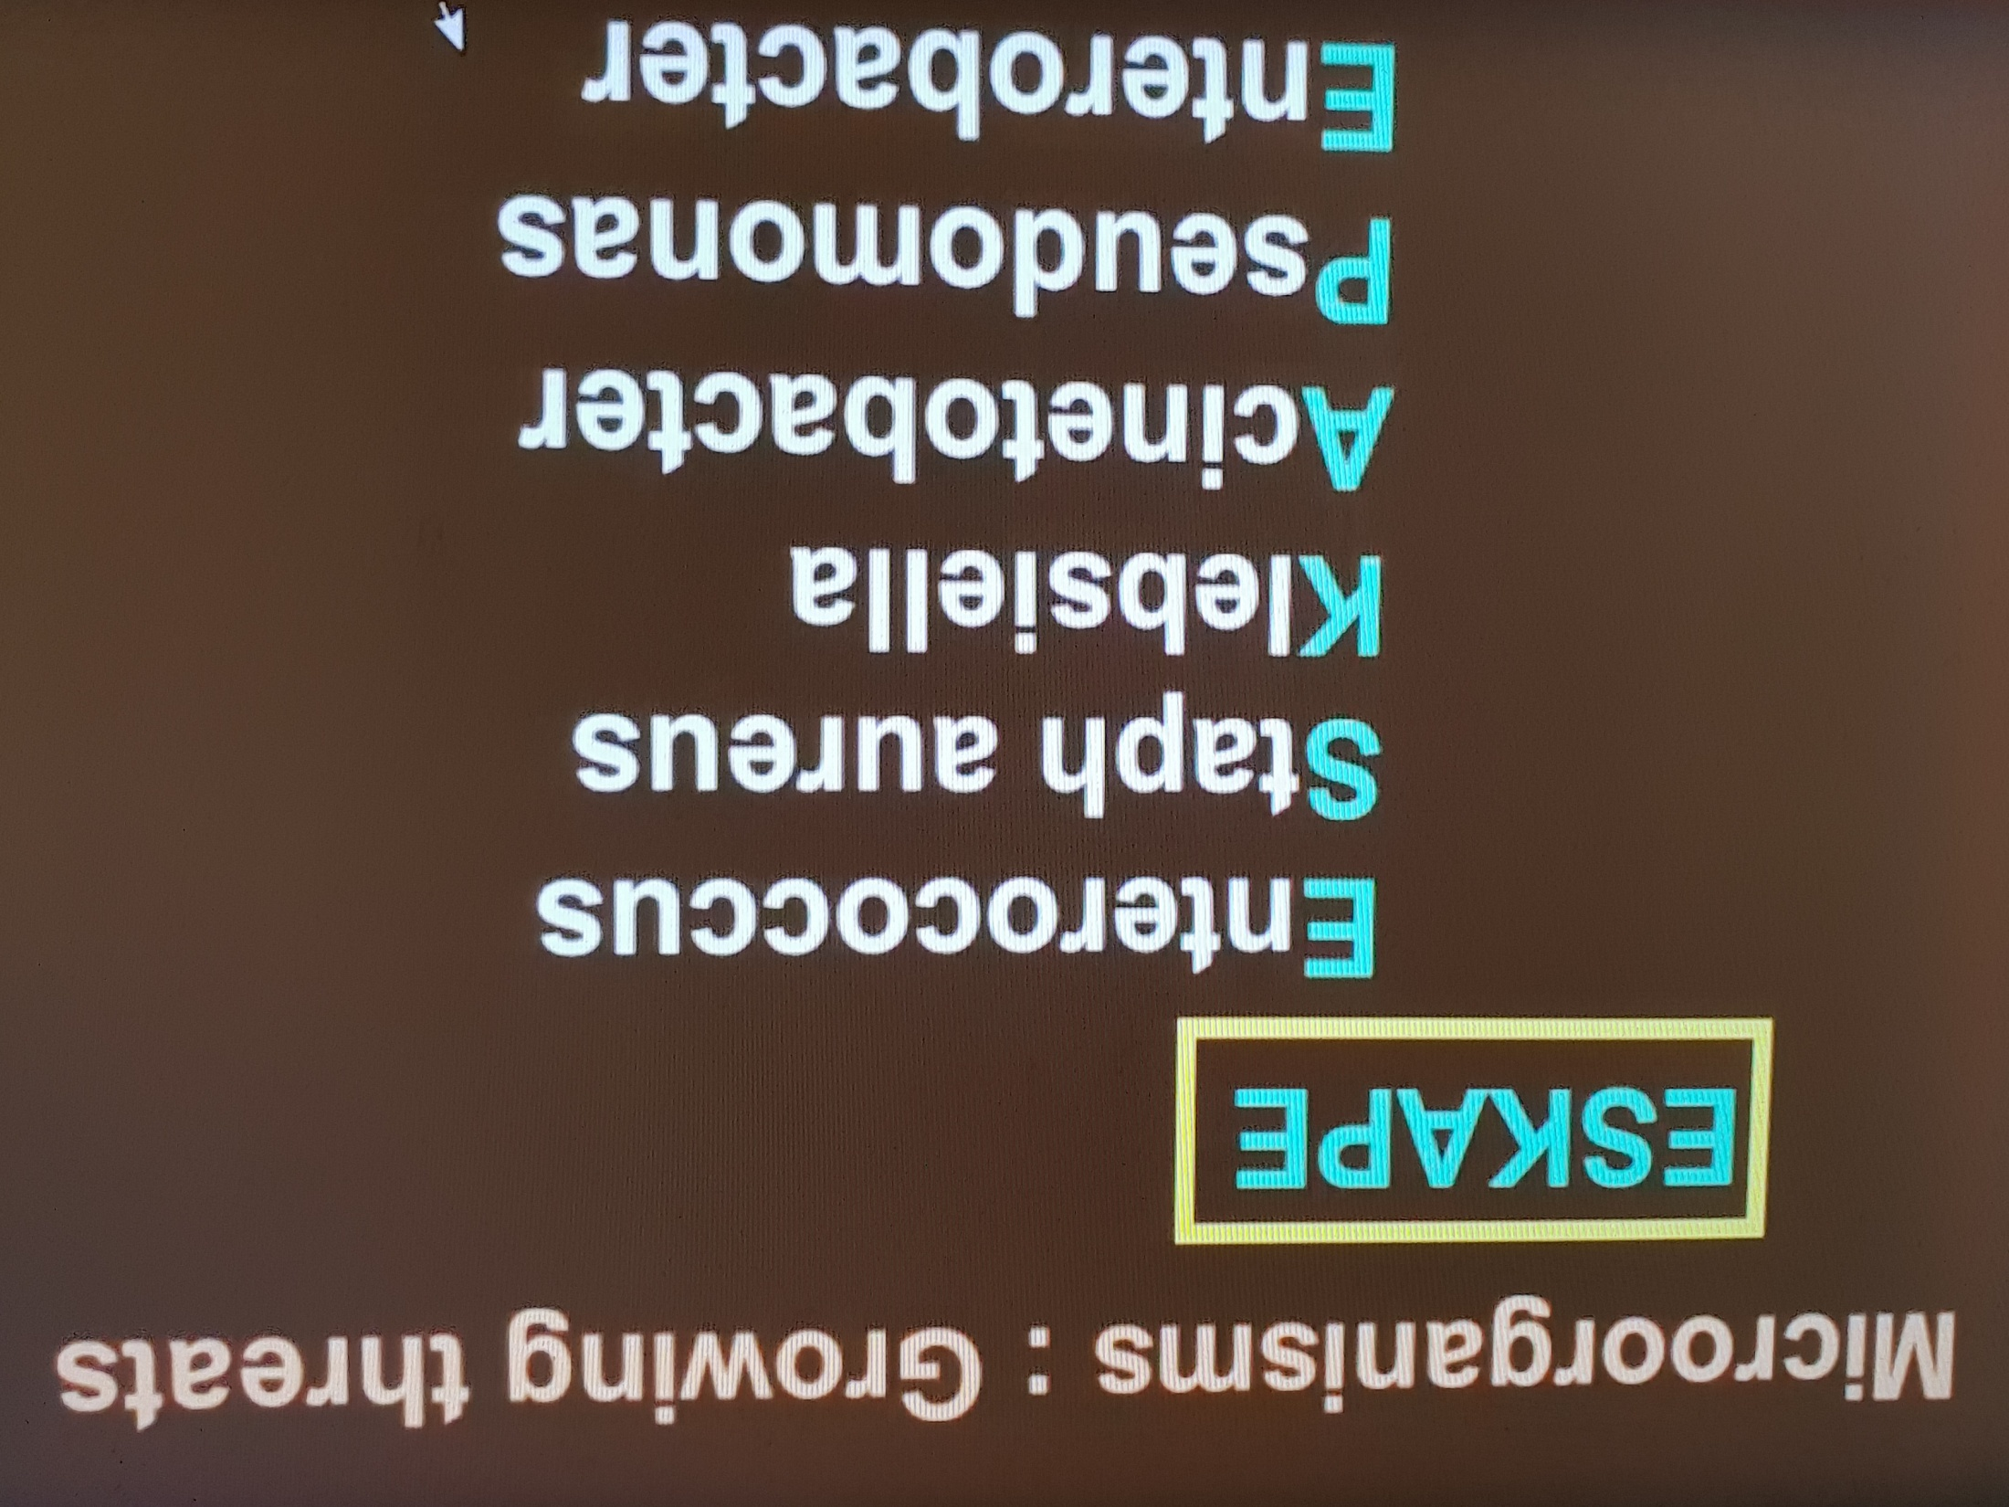

Slide 69
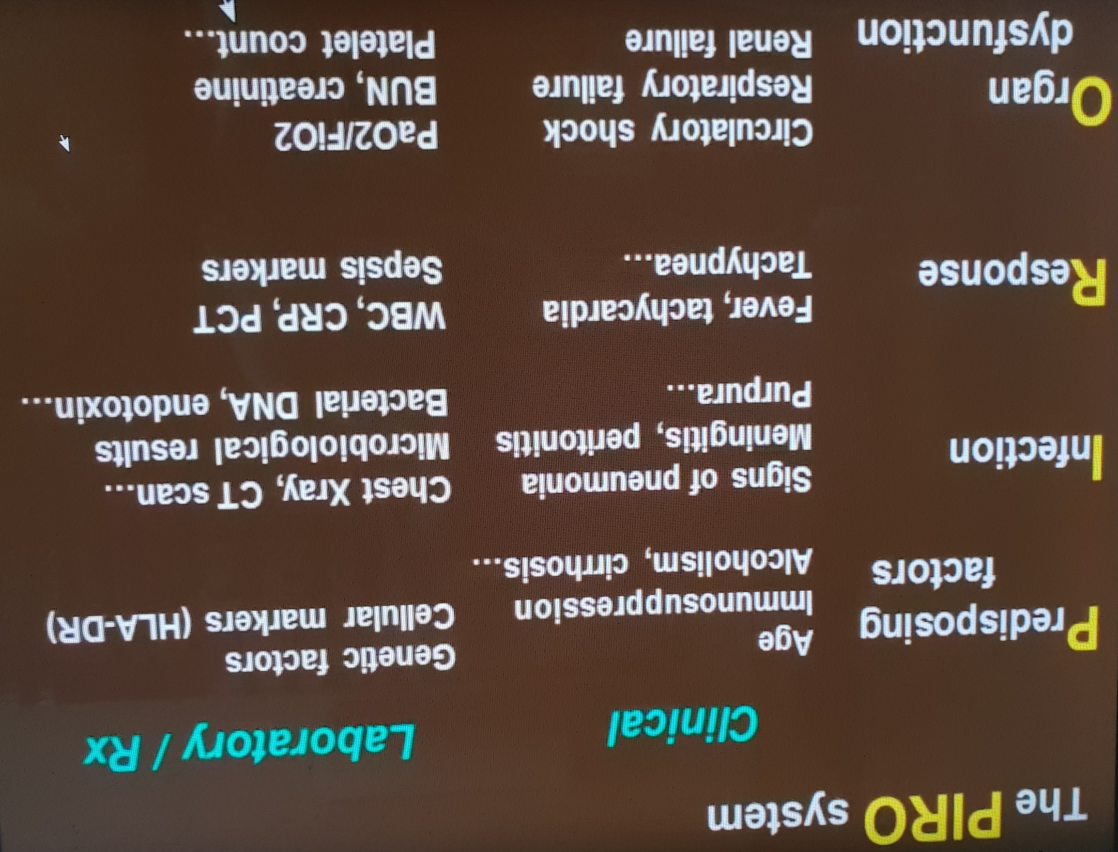

Slide 70
Sepsis ECONOMICS
Severe Sepsis and Septic Shock are subsets of sepsis conditions with at least one organ dysfunction, which accounts for 25-50% of in-hospital mortality…

Slide 71


Timeline of the SSC Guidelines
First edition in 2004
Previous Revisions in 2008 and 2012
Current revision started in 2014 and completed in 2016 which was Jointly sponsored by ESICM and SCCM

Slide 72
Recommendations of SSC 2016
93 Recommendations
  32 Strong recommendations: “We recommend”
  39 Weak recommendations: “We suggest”
  18 Best Practice Statements (BPS)
The recommendations are intended to provide guidance for the clinician caring for adult patients with Sepsis or septic shock.

Slide 73

Management According to SSC Guidelines

Slide 74
SURVIVING SEPSIS CAMPAIGN
STEP 1: Identify SEPSIS
STEP 2: Categorize SEPSIS
STEP 3: Initiate TREATMENT
Notes:
Surviving Sepsis Campaign is important to know as specific at UCI we are taking an aggressive approach to septic patients from admission to ICU.
Key Steps

Slide 75
Antimicrobial Therapy
Administration of IV antimicrobials within one hour for both sepsis and septic shock
Empiric broad-spectrum therapy with one or more antimicrobials to cover all likely pathogens (including bacterial and potentially fungal or viral coverage)

Slide 76
Empiric antimicrobial therapy be narrowed once pathogen identification and sensitivities are established and/or adequate clinical improvement is noted.
SSC against the use of systemic antimicrobial prophylaxis in patients with severe inflammatory states of noninfectious origin (e.g., severe pancreatitis, burn injury)

Slide 77
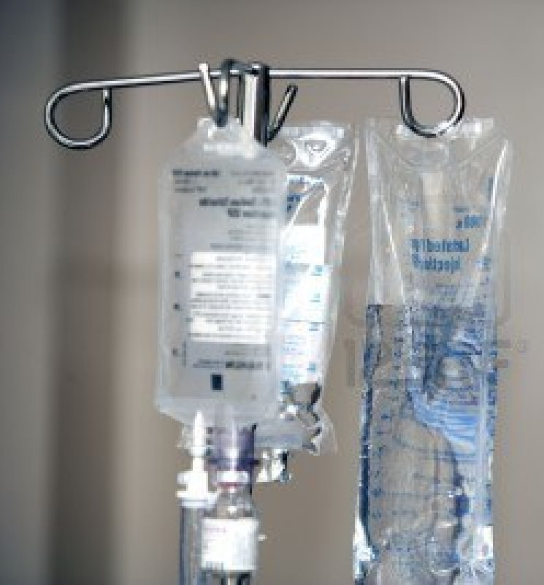
ANTIBIOTIC THERAPY
Started within 3 hrs after severe sepsis presentation
Monotherapy vs. Combination Therapy

Slide 78

3-Hour Bundle
To be completed within 3 hours of time of presentation*:
Measure lactate level
Obtain 2 sets of blood cultures prior to administration of antibiotics from 2 different sites.
Administer broad spectrum antibiotics
Administer 30ml/kg crystalloid IVF for hypotension or lactate ≥ 4 mmol/L
* “Time of presentation” is defined as the time of earliest chart annotation consistent with all the elements of severe sepsis or septic shock ascertained through chart review.
http://www.survivingsepsis.org/SiteCollectionDocuments/SSC_Bundle.pdf

Slide 79
6-Hour Bundle
To be completed within 6 hours of time of presentation
Apply vasopressors (for hypotension that does not respond to initial fluid resuscitation) and titrate pressors to a mean arterial pressure (MAP) ≥ 65 mm Hg.
In the event of persistent hypotension after initial fluid bolus (MAP < 65 mm Hg) or if initial lactate was ≥ 4 mmol/L, re-assess volume status and tissue perfusion and document findings.
If initial lactate is elevated > 2, re-measure lactate within 6 hours.
http://www.survivingsepsis.org/SiteCollectionDocuments/SSC_Bundle.pdf

Slide 80
SEPTIC SHOCK ONLY
Severe Sepsis
Time Zero
3 hr.
6 hr.
Interventions Required:
Persistent Hypotension
Within 1 hour of fluid add VASOPRESSOR
Persistent Hypotension
OR Lactate > 4
Shock Assessment (1 of 2)
Interventions Required:
ALL of Severe Sepsis +
Fluid 30 ml/kg
(NO exclusionary criteria)
Shock Assessment
Physical Exam (ALL)
Vital Signs (T, HR, RR, BP)
Cardiopulmonary exam
Capillary refill evaluation
Peripheral Pulse evaluation
Skin evaluation
Hemodynamics (2 of 4)
CVP
SVO2
Bedside cardiovascular ultrasound
Passive leg raise / fluid challenge

Slide 81
The Sepsis Six
Give high-flow oxygen via non-rebreathe bag
Take blood cultures and consider source control
Give IV antibiotics according to local protocol
Start IV fluid resuscitation Hartmann’s or equivalent
Check lactate
Monitor hourly urine output consider catheterisation
within one hour
..plus Critical Care support to complete EGDT

Slide 82
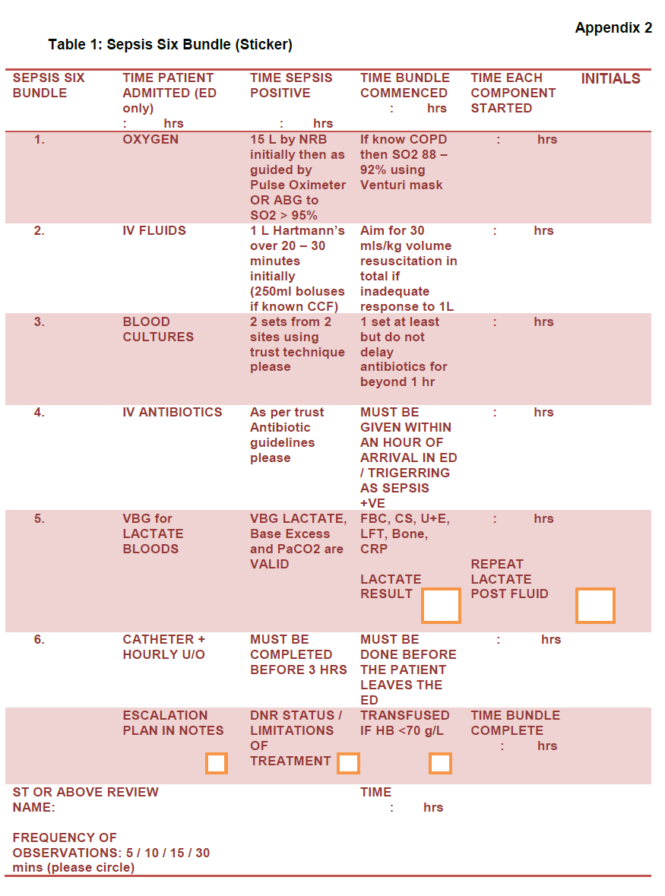

Slide 83
Duration of Treatment
Duration of treatment : 7 to 10 days is adequate .
Longer courses are appropriate in patients who have
Slow clinical response,
Undrainable foci of infection,
Bacteremia with S aureus,
Some fungal and viral infections,
Immunologic deficiencies, including neutropenia.

Slide 84
Antibiotics
  Cultures / Antibiotics / Labs
    Cultures PRIOR to Antibiotics ( 2 Sets, one peripheral and one from any line older than 48hrs)
    IV Abx within 3 hrs in the ED, within 1 hr in the ICU
      Broad Spectrum, combination therapy for neutropenic and patients with pseudomonas risk factors
      Vancomycin PLUS Zosyn
  Consider need for Source Control !
    Drainage of abscess or cholangitis, removal of infected catheters, debridement or amputation of osteomyelitis
Notes:
Stress importance of early cultures and IV antibiotics (BROAD).
Think Source control if relevant for your patient and possible need for surgery evaluation.

Slide 85
COMBINATION THERAPY
Choose Aminoglycosides or Aztreonam or Ciprofloxacin
Cephalosporins, (1st and 2nd Generation) - or – Clindamycin - or - Daptomycin - or - Glycopeptides - or - Linezolid - or - Macrolides - or - Penicillins

Slide 86
Effective Antimicrobial Therapy &
Survival in Septic Shock
1.0
survival fraction
cumulative antibiotic initiation
0.8
0.6
fraction of total patients
0.4
0.2
0.0
0-0.5
0.5-1
1-2
2-3
3-4
4-5
5-6
6-9
9-12
12-24
24-36
36+
time from hypotension onset (hrs)
Kumar et al. CCM. 2006:34:1589-96.

Slide 87
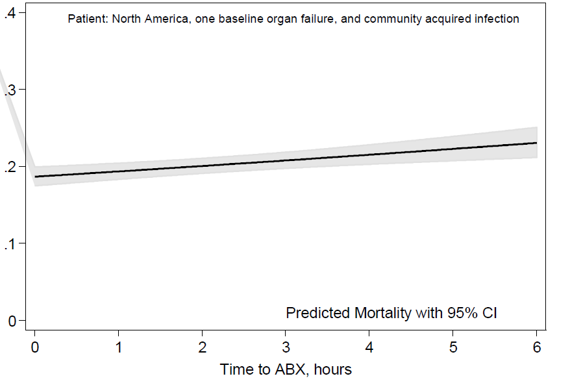
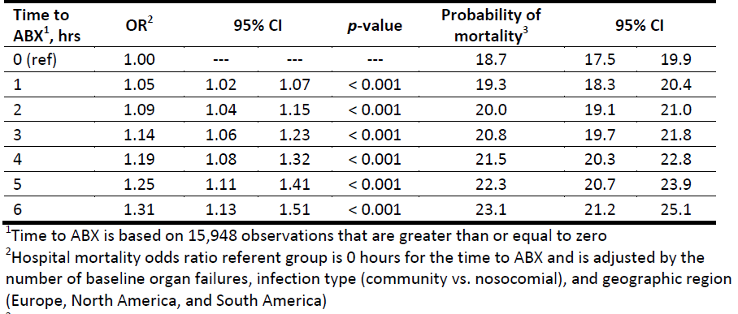
Hospital Mortality by Time to Antibiotics

Slide 88
Running average survival in septic shock based on antibiotic delay (n=2154)
For each hour’s delay in administering antibiotics in septic shock, mortality increases by 7.6%
Funk and Kumar
Critical Care Clinics 2011 (in press)
Notes:
This is soon to be published data from Canada: now prospective, over 4000 patients, clearly shows abx delays cost lives. Ignore the yellow curve, the pink’s the impt one!

Slide 89
Fluid therapy
Central Line Access (Fluid hydration +/- pressor)
1st line therapy – fluids, fluids, fluids!
Crystalloid equivalent to colloid
Initial 1-2 Liters (30ml /kg) crystalloid or 500 ml colloid
Careful in CHF patients !!

Slide 90
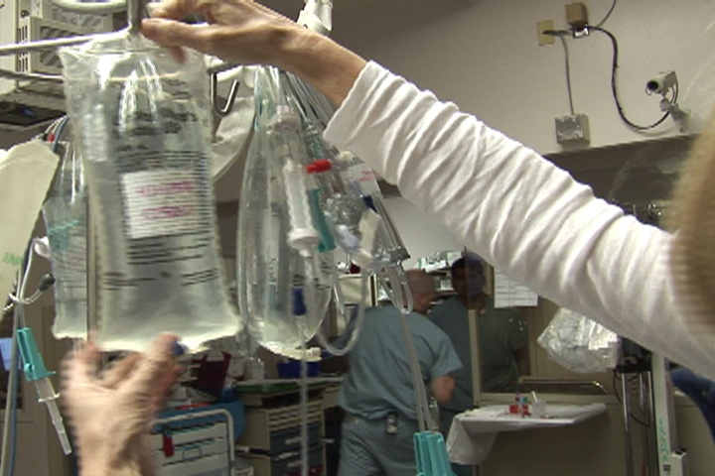
FLUID RESUSCITATION

Slide 91

Choice of Fluids
Crystalloids
Colloids
Ringers
Lactate
Normal
Saline
Gelatins
Hetastarch
Albumin

Slide 92
IV FLUID COMPOSITIONS

Slide 93
Fluid therapy…
Fluid challenge technique be applied where fluid administration is continued as long as hemodynamic factors continue to improve.
We recommend crystalloids as the fluid of choice for initial resuscitation and subsequent intravascular volume replacement in patients with sepsis and septic shock.

Slide 94
Using albumin in addition to crystalloids for initial resuscitation and subsequent intravascular volume replacement when patients require substantial amounts of crystalloids is weakly recommended.
SSC against the using of hydroxyethyl starches (HESs) for intravascular volume replacement in patients with sepsis or septic shock

Slide 95
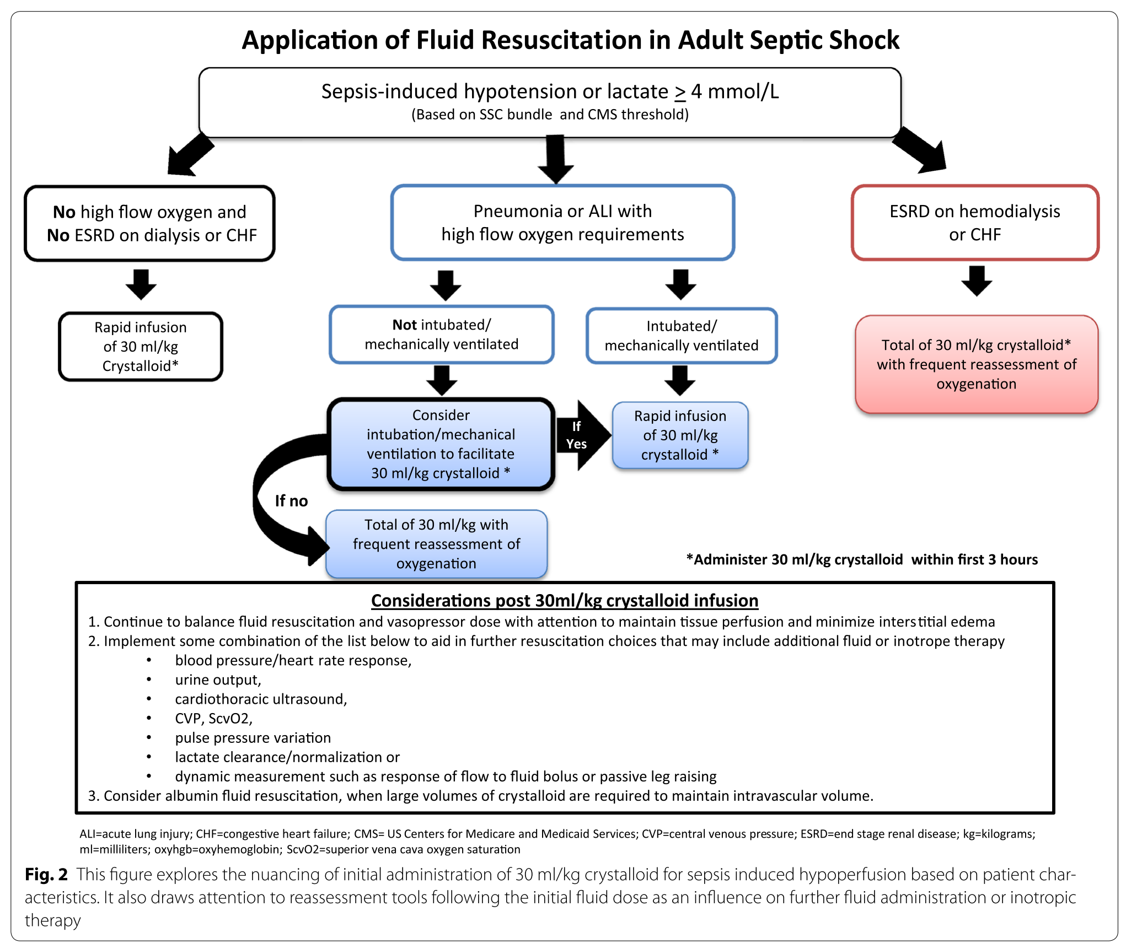
Newest Evidence-Based Guidelines Published in 2017
Remember Septic Shock is a Clinical Diagnosis!
Data Source: A Users Guide to the 2016 Surviving Sepsis Guidelines. Society of Critical care Medicine. March 2017 Volume 45 Number 3.

Slide 96
Fluid therapy
We recommend that initial fluid challenge in patients with sepsis-induced tissue hypoperfusion with suspicion of hypovolemnic be started with ≥ 1000 mL of crystalloids
(to achieve a minimum of 30ml/kg of crystalloids in the first 4 to 6 hours).

Slide 97
RESEARCH RECOMMENDATION
SCCM recommends that, in the resuscitation of sepsis-induced hypoperfusion, at least 30 ml/kg of IV crystalloid fluid be given within the first 3 hours (strong recommendation, low quality of evidence).

Slide 98
Vasoactive medications
Norepinephrine as the first-choice of vasopressor
Adding either vasopressin (up to 0.03 U/min) or epinephrine to norepinephrine with the intent of raising MAP to target, or adding vasopressin (up to 0.03 U/min to decrease norepinephrine dosage.

Slide 99
Using dopamine as an alternative vasopressor agent to norepinephrine only in highly selected patients (e.g., patients with low risk of tachyarrhythmias and absolute or relative bradycardia)

Slide 100
SSC against using low-dose dopamine for renal protection
Using dobutamine in patients who show evidence of persistent hypoperfusion despite adequate fluid loading and the use of vasopressor agents

Slide 101
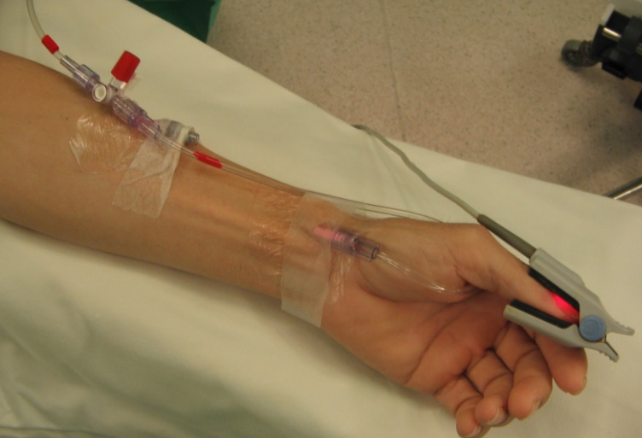
All patients requiring vasopressors should have an arterial catheter placed as soon as possible if resources are available

Slide 102
Choice of VASOPRESSERS
Norepinephrine
First Line
Epinephrine
Low Dose Vasopressin
(.01-.03 units/min)
Second Line
Niche Drugs
Dopamine (sinus bradycardia)
Phenylephrine
(high cardiac output or serious tachyarrhythmias and salvage)

Slide 103
Corticosteroids
Using IV hydrocortisone is not recommended to treat septic shock patients if adequate fluid resuscitation and vasopressor therapy are able to restore hemodynamic stability.
If this is not achievable, IV hydrocortisone at a dose of 200 mg per day ma be used

Slide 104
Corticosteroids
Use in Septic Shock, if NO response to vasopressors and fluids
  HYDROCORTISONE 200mg -300mg / day Divided doses (Q6hrs)
    Initial Dose 100mg IV x1
    Consider for patients who received etomidate
    No need for cosyntropin stim test
    Wean Steroids QUICKLY once off pressors
Notes:
2 Trials
Annane et al, JAMA 2002; 228: 862-871
Corticus Trial, NEJM 2008; 358: 111-124

Slide 105


Slide 106
Blood products
RBC transfusion only when hemoglobin concentration decreases to < 7.0 g/dL.
No recommendation to use of erythropoietin for treatment of anemia associated with sepsis.
Use of fresh frozen plasma is not recommended to correct clotting abnormalities in the absence of bleeding or planned invasive procedures

Slide 107
Prophylactic platelet transfusion….
When counts are < 10,000/mm3 in the absence of apparent bleeding
When counts are < 20,000/mm3 if the patient has a significant risk of bleeding.
Higher platelet counts (≥ 50,000/mm3 are advised for active bleeding, surgery or invasive procedures

Slide 108
Glucose control….
Commencing insulin when two consecutive blood glucose levels are > 180 mg/dL
Blood glucose values be monitored every 1 to 2 hours until glucose values and insulin infusion rates are stable, then every 4 hours thereafter in patients receiving insulin infusions.

Slide 109
Renal replacement therapy
Either continuous RRT (CRRT) or intermittent RRT can be used in patients with sepsis and acute kidney injury

Slide 110
CRRT can be used to facilitate management of fluid balance in hemodynamically unstable septic patients
SSC guidelines against the use of RRT in patients with sepsis and acute kidney injury for increase in creatinine or oliguria without other definitive indications for dialysis.

Slide 111
Bicarbonate therapy
SSC against the use of sodium bicarbonate therapy to improve hemodynamics or to reduce vasopressor requirements in patients with hypoperfusion-induced lactic acidemia with pH ≥ 7.15

Slide 113
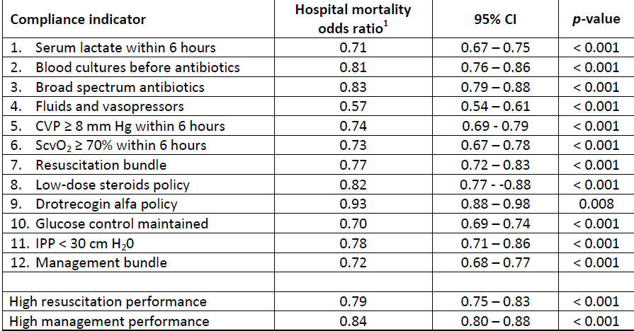
Logistic Regression Model

Slide 114
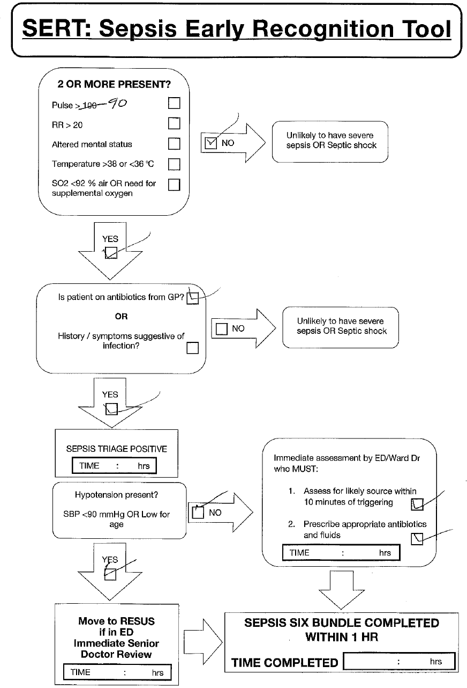

Slide 115

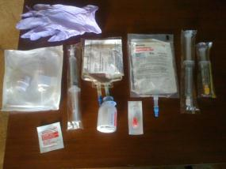
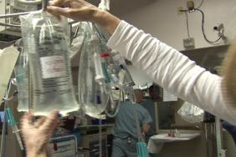
To Save Lives.....
Early identification
Early antibiotics
Early fluid resuscitation
Notes:
Insert vent, kumar article EGDT article sedation vacation bundles scattered

Slide 116

Keys to Survival
Early Identification
  Subtle signs and symptoms
  Don’t wait until your patient is hypotensive!
  Appropriate antibiotics in a timely manner
  For every hour antibiotics are delayed during septic shock, the patient’s risk of death increases by 7.6%
  The single most important intervention in treating sepsis
  Source Control
  Antibiotics
  Surgery
  IV Fluids and vasopressors if necessary (hemodynamic stability)
  Emergency supportive care for acute organ dysfunction
  Ventilator
  Continuous Renal Replacement Therapy (CRRT)
  Prone positioning

Slide 117
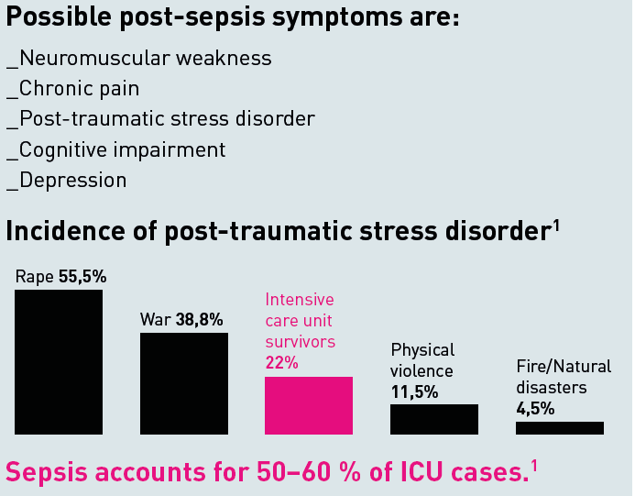

Patient’s journey does not end at discharge
Other symptoms can include:
Sleep disturbance, including insomnia
Extreme tiredness and fatigue
Inability to concentrate
Loss of confidence and self-belief
1_ Kessler RC, Sonnega A, Bromet E, et al.: Posttraumatic stress disorder in the National Comorbidity Survey. Arch Gen Psychiatry, 52: 1048–60, 1995. // Davydow DS, Gifford JM, Desai SV, et al.: Posttraumatic stress disorder in general intensive care unit survivors: a systematic review. Gen Hosp Psychiatry, 30: 421-434, 2008.

Slide 118

Healthcare Providers Can . . .
Prevent infections.
  Hand washing = #1 way to prevent infection
  Sterile Technique and Maintenance
    Foley insertion (and maintenance)
    Line insertion and draws ( maintenance)
    Invasive procedures
  Vaccines
    Flu and pneumonia shots
Reassess patient management. Check patient progress frequently. Reassess antibiotic therapy 24-48 hours or sooner to change therapy as needed (narrow the spectrum). Be sure the antibiotic type, dose, and duration are correct.
Educate patients and their families. Stress the need to prevent infections, manage chronic conditions, and seek care if signs of severe infection or sepsis are present.

Slide 119
KEY TAKE HOME POINTS
Recongnize Sepsis EARLY and determine SEVERITY
EARLY Antibiotics are critical to resolution of shock
RESUSCITATE severe sepsis and septic shock ASAP
EARLY GOAL DIRECTED THERAPY

Slide 120
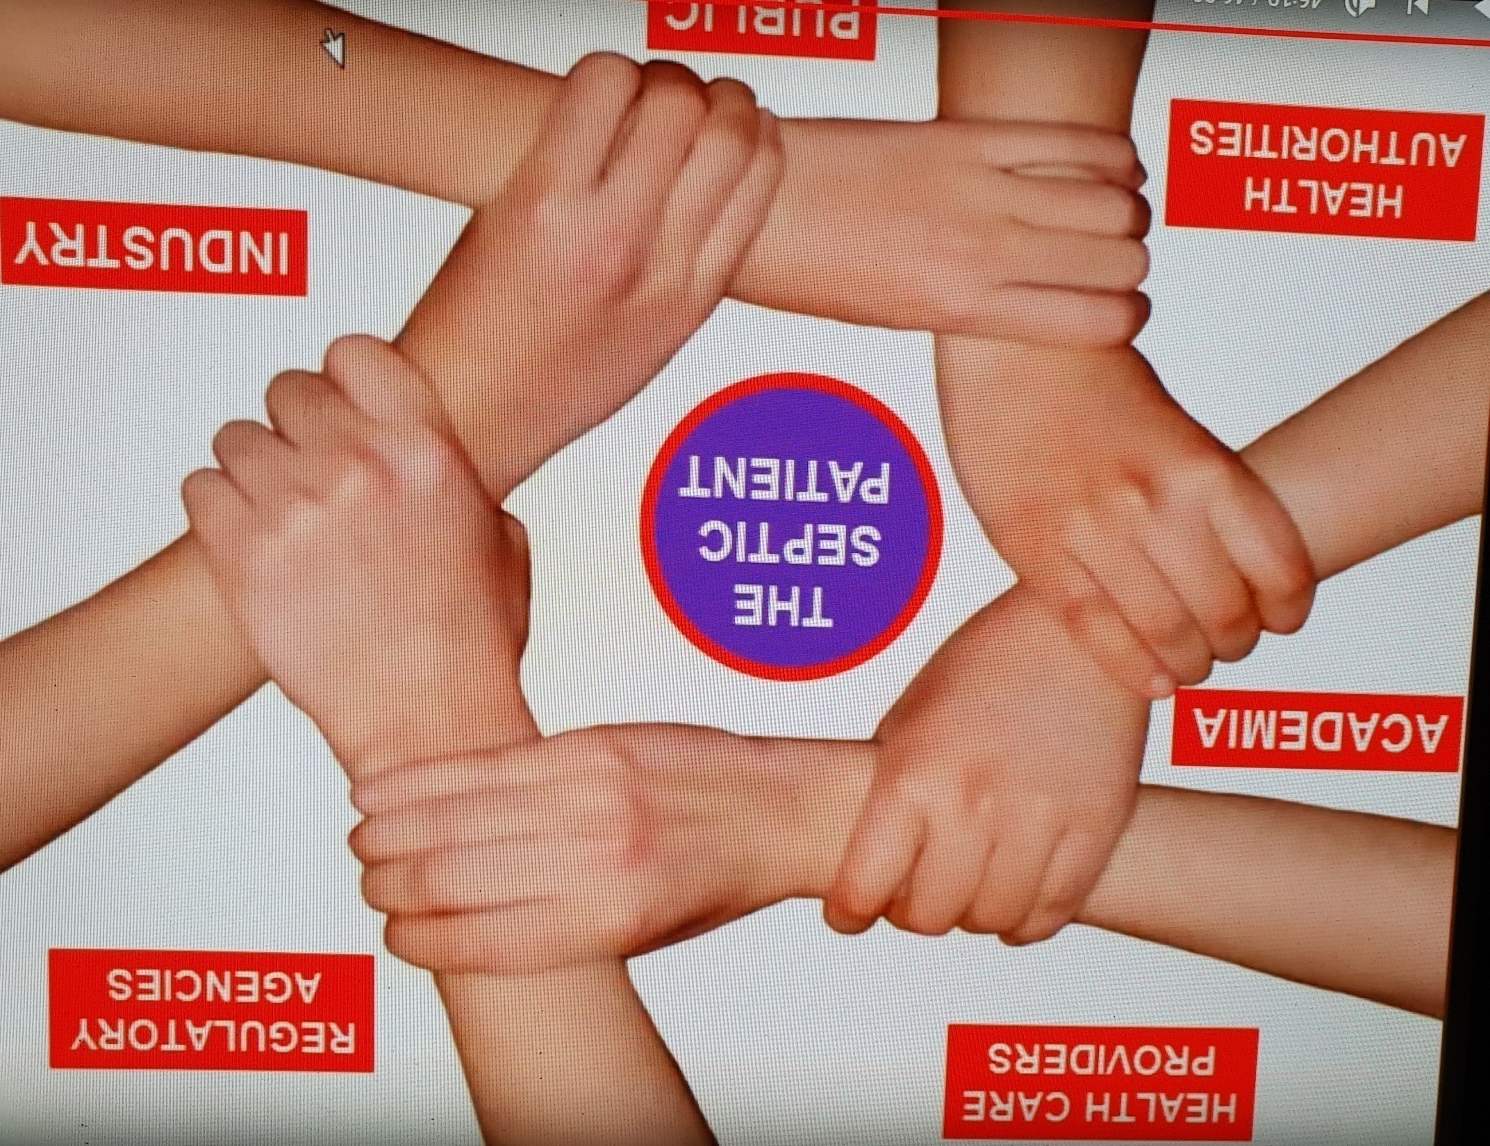

Slide 121
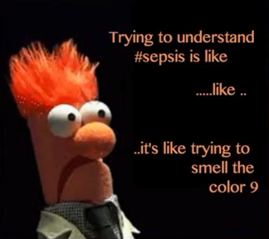

Slide 122
THANKS
FOR
PATIENCE
HEARING

